Slide 1
Borough of Stone Harbor
2018 Budget Presentation
March 6, 2018 4:30 PM

Slide 2
Borough Leadership
Mayor Judith M. Davies-Dunhour
Council Members:
Karen M. Lane, Council President
Joan T. Kramar
Joselyn O. Rich
Mantura Gallagher
Charles C. Krafczek
Ray Parzych
Jill Gougher, Borough Administrator
Suzanne Stanford, Borough Clerk
James Craft, Chief Financial Officer

Slide 3
Change in Current Fund Expenditures
Change over last year's budget appropriations |  |  |  |  |  | ($1,974,206)
Breakdown:
 | Salary and Wage Increase |  |  |  |  | 82,594
 | Other Expense - Change:
 |  | Grants |  |  | ($3,084,022)
 |  | Statutory Expenses - Pension |  |  | 52,175
 |  | Special Emergency |  |  | (55,000)
 |  | Change in Debt Service |  |  | 460,209
 |  | Cash for Prior Capital Projects |  |  | 175,650
 |  | Change in Capital Improvement Fund - Down Payments |  |  | 140,000
 |  | General Government |  |  | 254,188
 |  |  |  |  |  | ($2,056,800)
 |  |  |  |  |  | ($1,974,206)

Slide 4
Change in Current Fund Revenues
Change in Revenues |  |  |  |  | ($1,974,206)
Breakdown:
 | Increase in use of Surplus |  |  | $65,380
 | Increase in Local Revenues/State Aid/Misc |  |  | 75,808
 | Decrease in Grants W/Offsetting Appropriations |  |  | (3,084,022)
 | Other Special Items |  |  | 1,129
 |  |  |  |  | ($2,941,706)
Change in Local Tax Levy |  |  |  |  | $967,500
Total Change in Revenues |  |  |  |  | ($1,974,206)

Slide 5
2% Levy CAP Calculation
Prior Year Amount to be Raised by Taxation |  |  |  | 10,882,500
 |  | Less: Deferred Charges/Emergencies |  | (67,250.00)
Net Prior Year Tax Levy for Local Purpose Tax for CAP |  |  |  | 10,815,250
 | Calculation
 |  | Plus 2% CAP Increase |  | 216,305
Adjusted Tax levy Prior to Exclusions |  |  |  | 11,031,555
 | Exclusions:
 |  | Current Year Deferred Charges: Emergencies |  | 87,250
 |  | Debt Service/Capital |  | 731,434
 |  | Pension Obligation Increase |  | 24,815
 | Total Exclusions |  |  | 843,499
 |  | Less Cancelled or Unexpended Exclusions |  | 7,775
Adjusted Tax Levy |  |  |  | 11,867,279
 | Additions:
 |  | New Ratables - New Construction
 |  | Prior Year's Tax Rate (Local) | 0.245
 |  | Prior Year Cap Banks |  | 1,142,393
Maximum Allowable Amount To Be Raised By Taxation |  |  |  | 13,009,672
Amount To Be Raised By Taxation - Budget Sheet 11 |  |  |  | 11,850,000
 | Under 2% Levy CAP With Banking |  |  | (1,159,672)

Slide 6
STATUS OF SPENDING “CAPS”

Slide 7
Local Tax Levy and Assessed Values
Local Tax Levy and Assessed Values
 | 2018 | 2017 | Change | %
Local Purpose Tax Levy | 11,850,000.00 | 10,882,500.00 | $967,500.00 | 8.89%
Local Tax Rate | 0.245 | 0.245 | 0.000 | 0.00%
Assessed Valuation | 4,838,376,030 | 4,436,817,630 | 401,558,400 | 9.05%

Slide 8
CONDITION OF SURPLUS
 | BUDGET YEAR | PRIOR YEAR | CHANGE
Available | 2,806,069 | 2,620,986 | 185,083
Used to Fund Budget | 1,560,843 | 1,495,464 | 65,379
Remaining Balance | 1,245,226 | 1,125,522 | 119,704

Slide 9
Surplus Regeneration 2017 vs 2016
 |  |  |  | 2017 | 2016
Balance as 12/31/PR |  |  |  | $ 2,620,985.81 | $ 2,801,407.63
Excess from Operations |  |  |  | $ 1,680,547.39 | $ 1,331,998.65
Used in Budget |  |  |  | $ (1,495,463.96) | $ (1,512,420.47)
Balance as of 12/31/CR |  |  |  | $ 2,806,069.24 | $ 2,620,985.81
Percentage used |  |  |  | 59% | 54%

Slide 10
Tax Rates in Cape May County
Municipality | Local Tax Rate - 2017
Upper Township | 17.1
Dennis Township | 21.4
Avalon Borough | 22.6
Woodbine | 23.9
Stone Harbor | 24.5
Cape May Point | 29.6
Cape May City | 34.0
West Cape May | 35.6
Sea Isle City | 38.4
Ocean City | 44.9
Middle Township | 47.2
Lower Township | 57.4
Wildwood Crest | 66.1
North Wildwood | 70.8
West Wildwood | 95.2
Wildwood City | $1.348

Slide 11
Tax Rates in Cape May County
Municipality | General Tax Rate - 2017
Stone Harbor | .555
Avalon Borough | .556
Cape May Point | .586
Sea Isle City | .695
Cape May City | .884
Ocean City | .943
West Cape May | 1.222
Wildwood Crest | 1.233
North Wildwood | 1.242
Woodbine | 1.540
Dennis Township | 1.592
Lower Township | 1.697
Middle Township | 1.722
Upper Township | 1.744
West Wildwood | 1.812
Wildwood City | 2.394

Slide 12
PERCENTAGE OF TAX COLLECTION
 | CURRENT | PRIOR
Actual percentage of collection | 99.13% | 99.16%
Used for Reserve for Taxes | 98.21% | 98.10%
Remaining | 0.92% | 1.06%

Slide 13
Current Fund Revenue

Slide 14
Current Fund Appropriations

Slide 15
2018 Administration & Finance Summary
Administration & Finance Committee
Karen Lane, Chair
Mantura Gallagher
Charles Krafczek
The total for Administration and Finance is up $41,111 or 1.36%
Other Expenses is up slightly $5,537 or .256%
The most significant increase is in Mayor and Council OE for Non-profit support to the American Legion, Mammal Stranding Center and Volunteers in Medicine. Almost all Departmental Operating Expenses remained the same or decreased.
Salaries are up $35,574 or 4.16%
The most significant salary increase is in Construction due to the retirement of one employee and hiring of part-time code enforcement officer.

Slide 16
Administration & Finance Functional Areas
Administration and Finance include the following functional areas:
Administration which includes Council, Administrator, Municipal Clerk Office, Engineering and Finance
Tax Administration which includes Tax Collection and Tax Assessment
Planning and Zoning Boards
Legal Services
Construction Office
Insurance – Medical, General Liability, Workers Compensation, Property and Vehicle

Slide 18
2018 Public Safety Summary
2018 Public Safety Committee
Ray Parzych, Chair
Joselyn Rich
Mantura Gallagher
The overall Public Safety Budget is up $180,907 or 5.52%
Other Expenses is up $166,487 or 20.75%
Municipal Court, Public Defender, Fire Code Official and Emergency Management Other Expenses remained flat.
Aid to Volunteer Fire increased by $159,850 due to an amendment to the Stipend Program approved by Council.
Salaries and Wages are up $14,420 or .58% Dispatch Interlocal Agreement increased by $5,837 or 2%.
Animal Control is up slightly by $800

Slide 19
Public Safety Functional Areas
Public Safety includes the following function areas:
Police
Fire Department/EMS
Municipal Court including Public Defender and Prosecutor
Uniform Fire Code
Office of Emergency Management
Fire Hydrant Service
Beach Patrol and Taggers
Animal Control

Slide 21
2018 Public Works Summary
The Public Works budget has a overall increase of $78,550 or 3.7%
The Operating budgets have an increase of $50,950 or 8.99%
Public Works OE increased by $41,400. The biggest increase was for Uniform Service Contracts
Solid Waste Other Expenses increased by $1,000
Building & Grounds increased by $2,050 due to increases in service contracts and creating a line item for uniforms.
Safety Compliance increased by $2,100.
Landfill Fees increased by $4,400
Salaries and Wages increased by $27,600 or 1.8% due to contractual salaries
2018 Public Works Committee
Joan T. Kramar, Chair
Karen Lane
Ray Parzych

Slide 22
Public Works Functional Areas
The Public Works Departmental Functional areas include:
DPW Labor Pool
Solid Waste
Grounds
Special Events
Safety Compliance

Slide 24
2018 Natural Resources Summary
2018 Natural Resources Committee
Joselyn Rich, Chair
Joan Kramar
Ray Parzych
The Total Budget for Natural Resources for 2018 remained flat.
Salaries of $25,000 which was moved from Public Works to Natural Resources 2 years ago to better reflect expenses associated with the Bird Sanctuary and Point maintenance saw no increase.
Other Expenses remained at $61,000

Slide 25
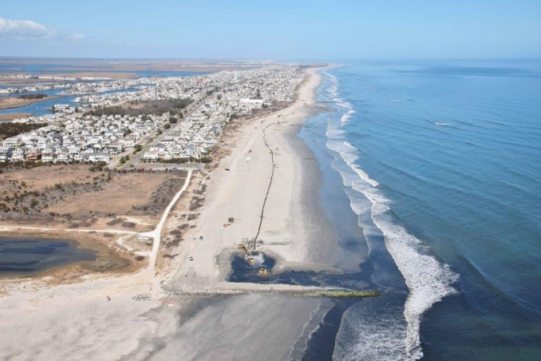
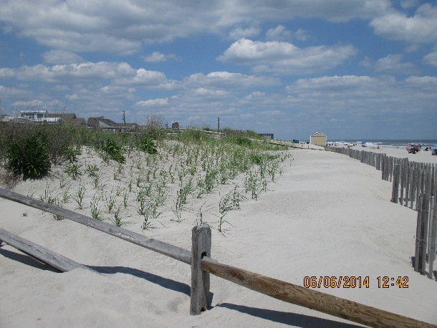
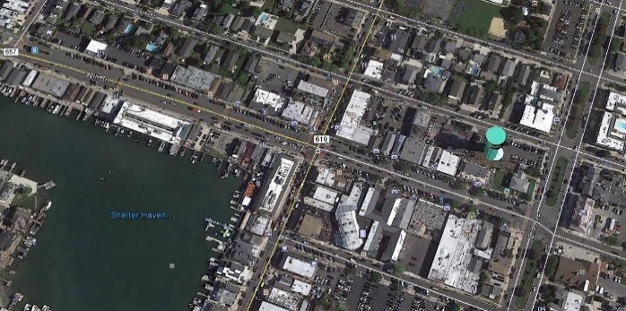
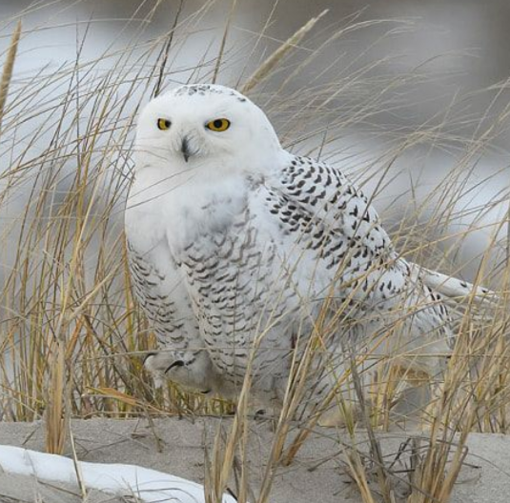
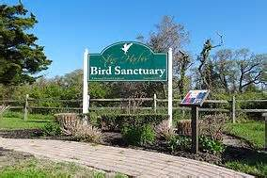
Natural Resources Functional Areas
Natural Resources Functional Areas include the preservation of:
Beach and Dunes
Back Bays
Bird Sanctuary
Stone Harbor Point

Slide 26
2018 Budget Appropriations Natural Resources

Slide 27
2018 Recreation and Tourism Summary
2018 Recreation & Tourism Committee
Mantura Gallagher, Chair
Joselyn Rich
Charles Krafczek
Recreation and Tourism saw an overall increase of $5,200 or 1.91%
Recreation OE increased by $200 or .10%.
Tourism remained flat.
Overall Salaries & Wages increased by $5,000 or 2.12%

Slide 28
Recreation and Tourism Functional Areas
Recreation and Tourism Functional Areas include:
Recreation
Tourism
Marina

Slide 30
Debt Service – Current Fund
Debt Service is the annual principal and interest payments
Current Fund totals $4,096,559. There is an increase over 2017 of $460,209 or 12.66%
Three types of debt service payments
General Obligation Loan – Serial bonds
2006 Issue $1,610,000 outstanding, matures in 2018. Partially refunding in 2016
2011 Issue $7,200,000 outstanding, matures in 2023. Interest rate between 3.0%-3.125%
2016 Refunding Issue of 2006 Bonds, matures in 2018
NJEIT Loan – $3,808,611.61 outstanding. Serial Bonds Issued by New Jersey Environmental Infrastructure Trust Fund. Water/Sewer projects are pooled together across many towns and NJEIT Issues a bond with AAA rating to finance the projects. Portions are interest free and may have loan forgiveness.
2010 Issue, 2012 Issue, 2015 issue all in connection with Water/Sewer Improvements
Bond Anticipation Notes (BANs) – $19,500.000 at 1.176% NIC. One year financing issued as needed to fund projects. We must make principal payments after 3 years. Eventually rolled into Serial Bonds.

Slide 31
Debt Creation – Current Fund
Debt is authorized through a Capital Improvement Ordinance passed by Borough Council.
Each project contains a description of the project, estimated life, total cost, minimum 5% down payment, and the balance is debt authorized.
Down payment is appropriated in the Current Fund, Sheet 26, titled Capital Improvement Fund.
This year’s appropriation is $350,000
Not all debt authorized is financed from Serial Bonds/NJEIT/BANS.
Listed as Authorized but not issued, totals $11,254,131.05.
BANS are not issued until need is expected. Some project balances will be canceled before issuing Serial Bonds.

Slide 32
Debt – Annual Debt Statement
All of the debt mentioned is included in an annual report – ‘Annual Debt Statement’ (ADS) that is required to be filed by January 30 after year end.
ADS also includes debt from the Water/Sewer utility. However, if the utility is “self-liquidating”, Revenues are greater than expenditures, the debt is not included in the debt limit.
Debt limit is 3.5% of the 3 year equalized valuation of real property. This year that limit is $150,749,523.46.
At 12/31/17, net debt totaled $36,272,760, as a percentage of equalized valuation was .842%.

Slide 34
General Capital highlights
Various Road Improvements | $4,080,000
Beach & Bay Improvements ($50k each) | $100,000
Recycling/Trash Truck | $230,000
Bulkhead - 114th Streets | $400,000
ADA Improvements & Restroom Renovation | $400,000
Beach Tractor/Loader | $160,000
Police Equipment/Vehicle/Computer/* | $92,000
Building Improvements – Borough Hall * | $20,000
Beach Patrol Equipment/Stands/Building Improvements* | $59,000
Various Public Work Items/Improvements * | $199,000
* Project funded 100% with Surplus

Slide 35
Water and Sewer 2018 Budget

Slide 36
Water & Sewer Utility Fund Summary
Water & Sewer Utility Fund Committee
Charles Krafczek, Chair
Joan Kramar
Karen Lane
There is an overall increase in the Utility Budget of $216,766 or 5.52%
There is a increase in Other Expenses of $6,700 or 1.29%
Cape May County MUA Fee: There is a decrease of $99,960 or 6.04%
Debt Service increased by $249,664 or 19.64 %
Statutory Charges remained flat.
Capital Increased by $60,000

Slide 37
Water & Sewer Functional Areas
Water and Sewer Functional Areas include:
Operation of Sanitary Sewer Pump Stations
Operation of Water System
Maintenance of Sanitary Sewer Pump Stations
Maintenance of Water System, Water Tower and Water Wells
Collection of Water and Sewer Rents

Slide 38
Water/Sewer Fund Revenue

Slide 39
Water Sewer Fund Appropriations

Slide 40
Water/Sewer Capital highlights
Various Infrastructure/Road Improvements | $1,620,000
Meter/IRT Upgrades | $200,000
Storm Water Vaults & Pipe Installation | $100,000
Sewer Camera | $98,000
SCATA Well & Lift Remote Monitoring | $50,000
Outfall Duck Bill Replacement | $30,000

Slide 41
To view this presentation and additional Financial Information click on or go to the following link found on the Borough of Stone Harbor’s Municipal Website:
http://stoneharbor.nj.org/departments/finance/department-of-finance/

