Slide 1
BOROUGH UPDATES
September 14, 2019
Judy Davies-Dunhour
Mayor

Slide 2
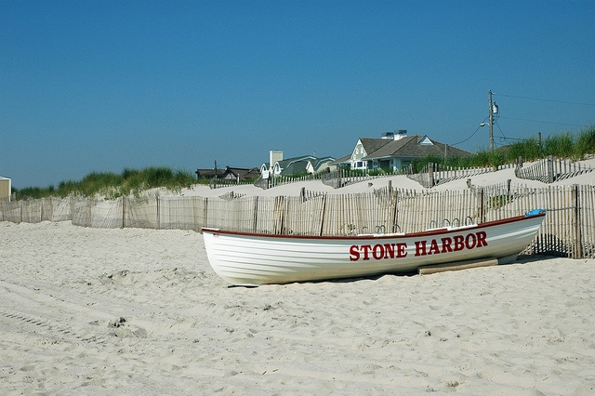
TODAY’S TOPICS
Lifeguard Building
Smuggler’s Cove Properties
96th Street & Third Avenue
2020 Budget Timeline
Five Year Operating Budget
Ten Year Strategic Plan
2019 Road Program
Sewer Pump Station
Stormwater Pump Station

Slide 3
2019 ROAD PROGRAM
This project is in design and scheduled to go bid in October 2019.
Construction is scheduled to start in early 2020 and be completed by Fall 2020.
The Streets in this project include:
87th Street (Third Avenue to Sunset Drive)
88th Street (Third Avenue to Sunset Drive)
88th Street (Second Avenue to Third Avenue)
89th Street (Second Avenue to Third Avenue)
90th Street (Second Avenue to Third Avenue)
91st Street (Second Avenue to Third Avenue)
105th Street (First Avenue to Second Avenue)
118th Street (Second Avenue to Third Avenue)

Slide 4
2020 FIVE YEAR BUDGET CALENDAR – OPERATING AND CAPITAL
September 3 Work Session: Other Expenses (A&F, Public Works, Utilities)
September 17 Work Session: Other Expenses (Natural Resources, Recreation & Tourism, Public Safety)
October 1 Work Session: Capital Requests (A&F, Public Works, Utilities)
October 15 Work Session: Capital Requests (Natural Resources, Recreation & Tourism)
November 5 Work Session: Review (5) year Other Expenses Plan
November 19 Work Session: Review (5) year Capital Expense Plan
November 19 Council Meeting: Closed Session Discussion of 2020 Salaries
December 3 Work Session (5) year revenue projections
December 17 Work Session: Review of 2020 Budget to include OE, Salaries & Capital
January 21 Work Session: Update Revenue Projections, Tax Rate, Budget Review

Slide 5
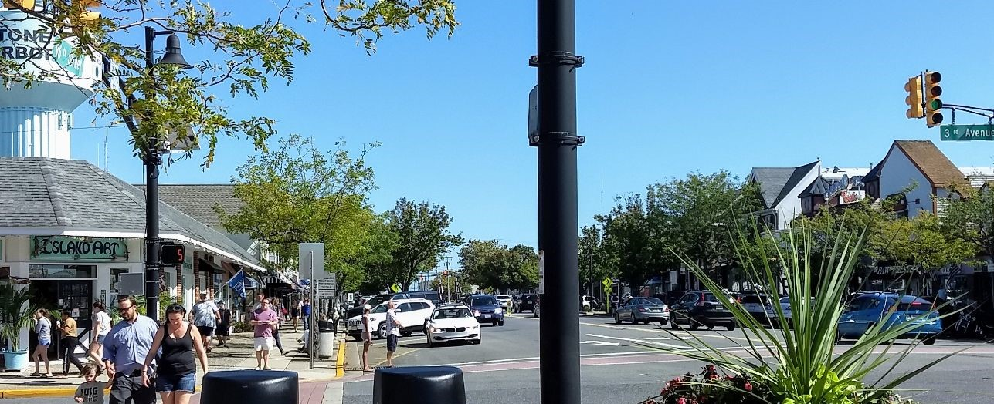
96th Street & Third Avenue
GREEN
WALK
Solutions?
RED left turn arrow Police Presence
Audible Directions ALL WALK

Slide 6
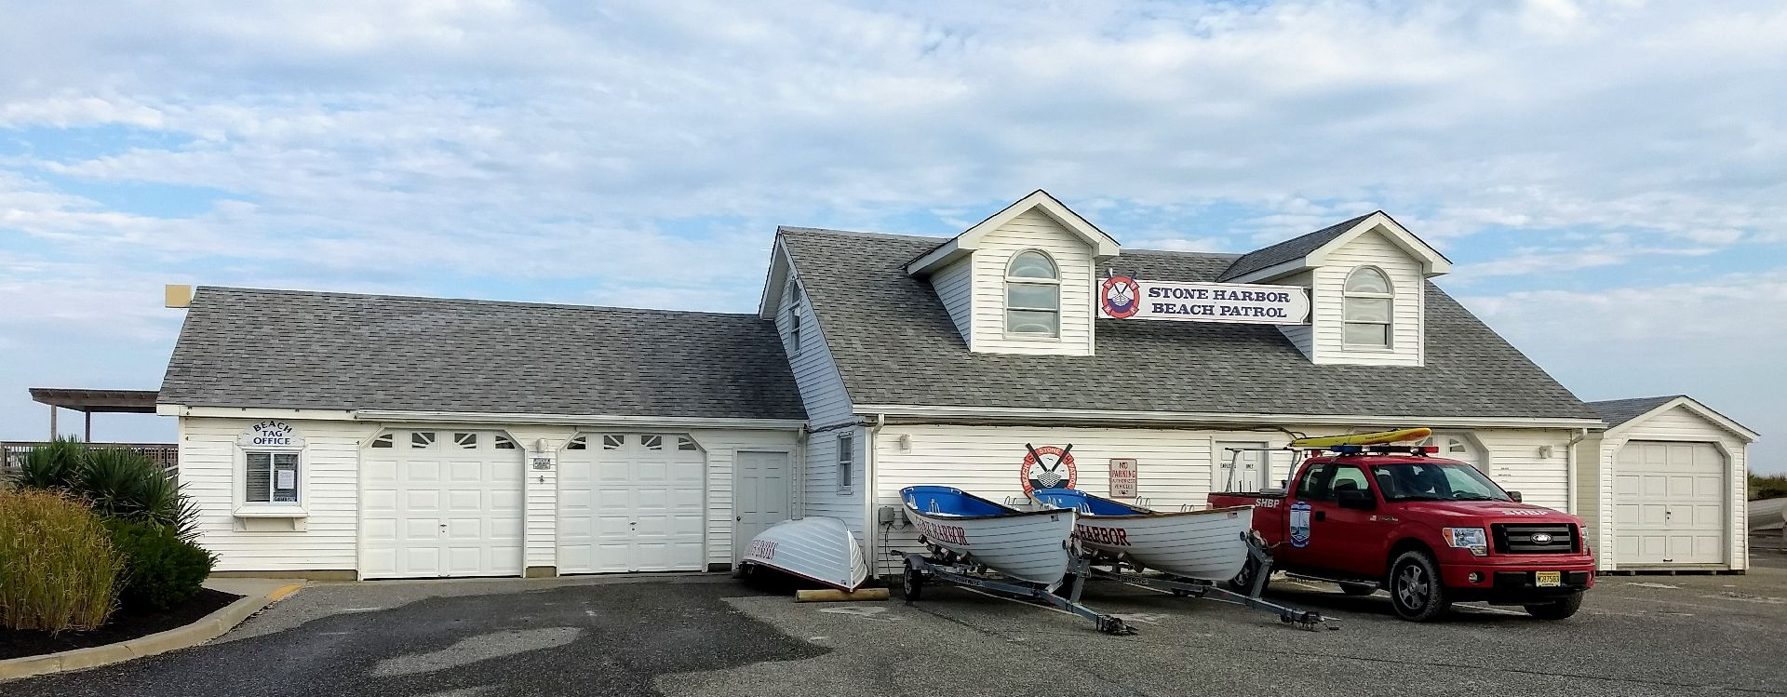
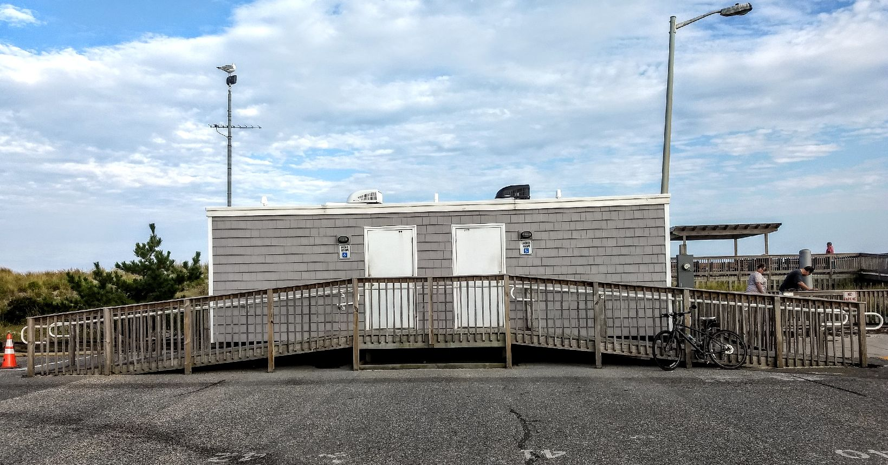
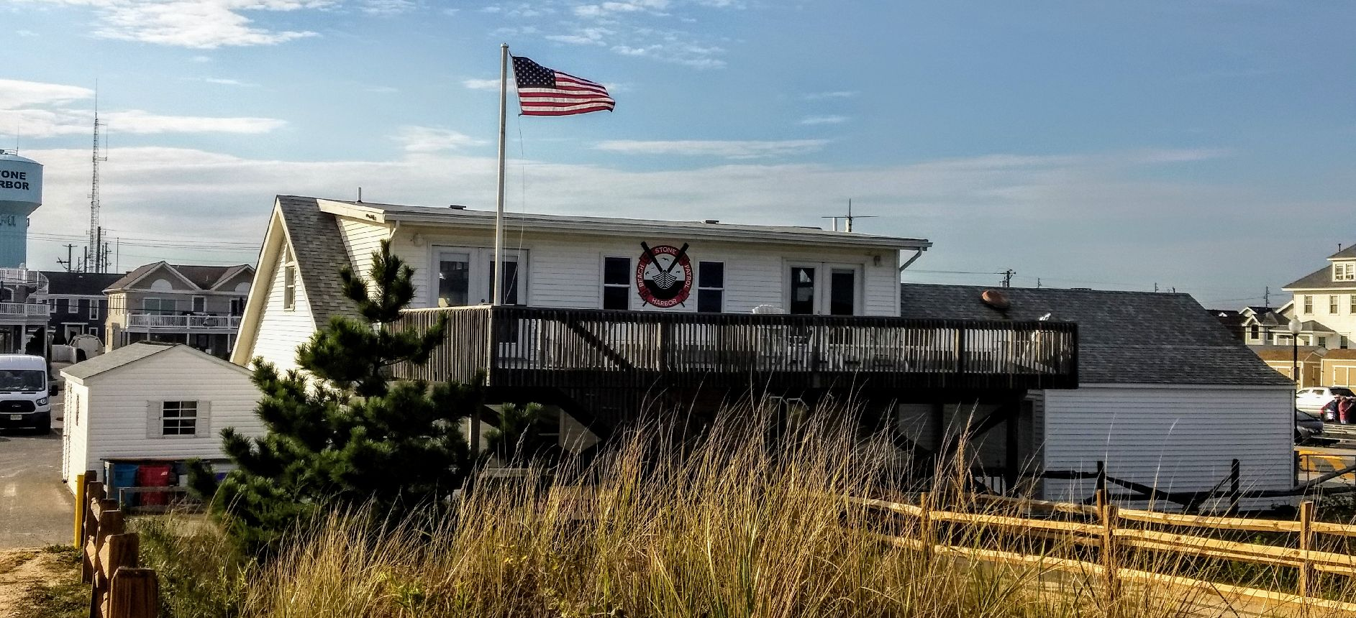
Beach Patrol Headquarters
95th Street Restrooms

Slide 7
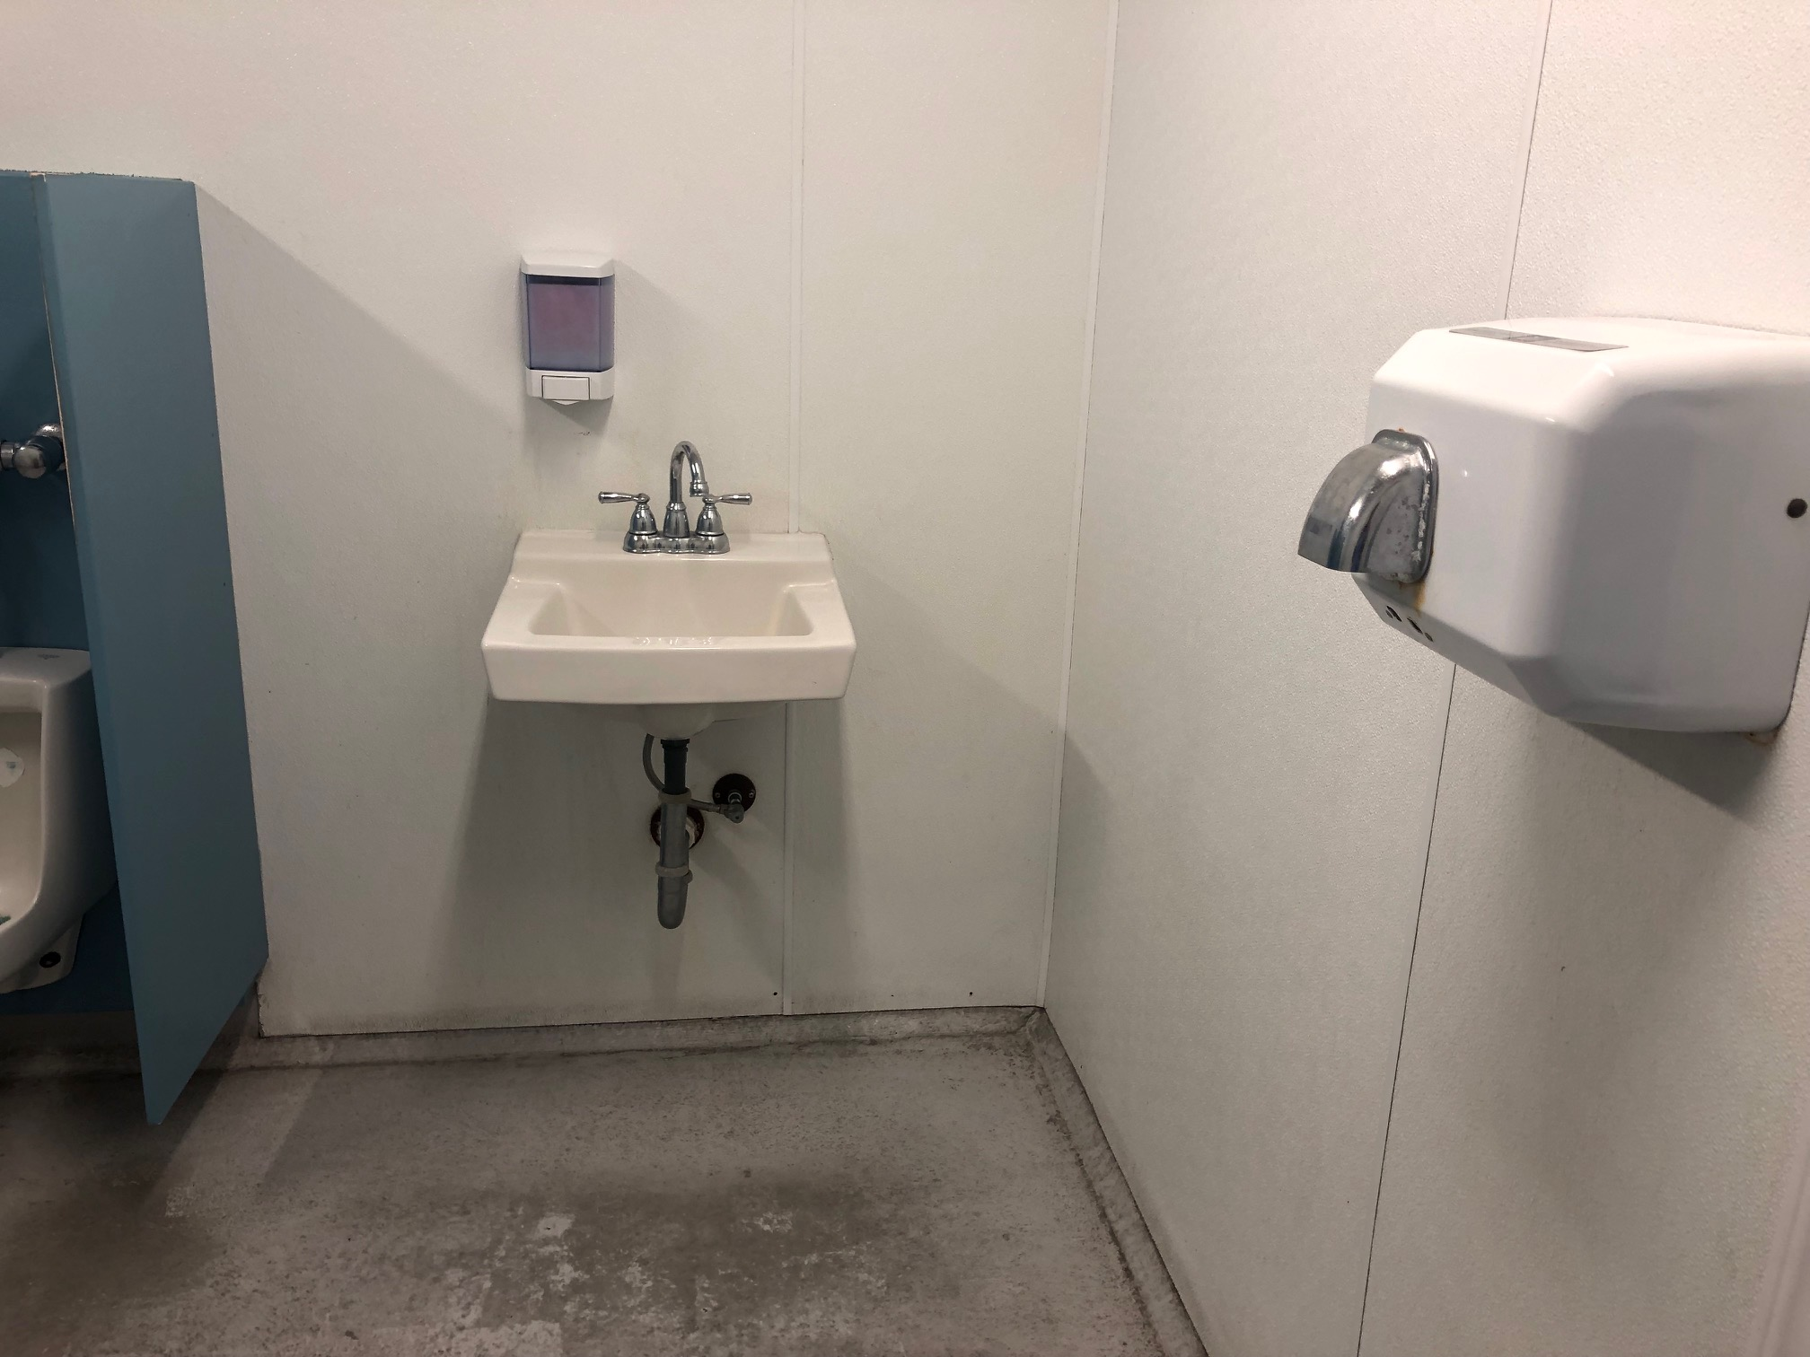
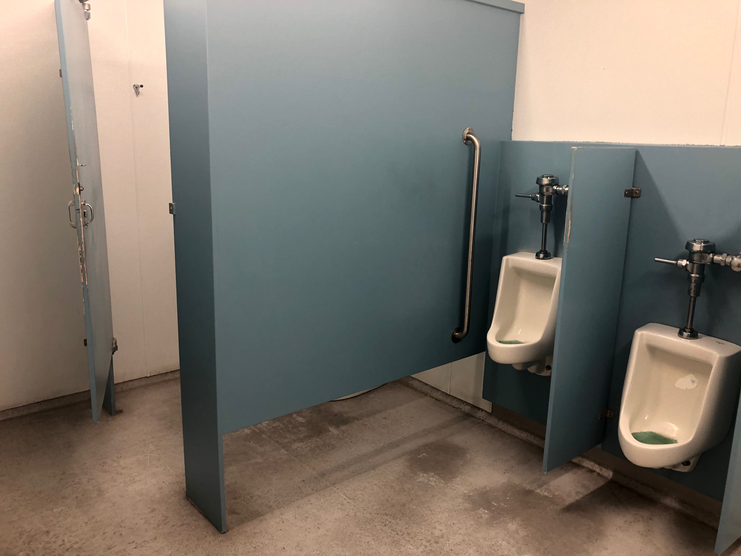
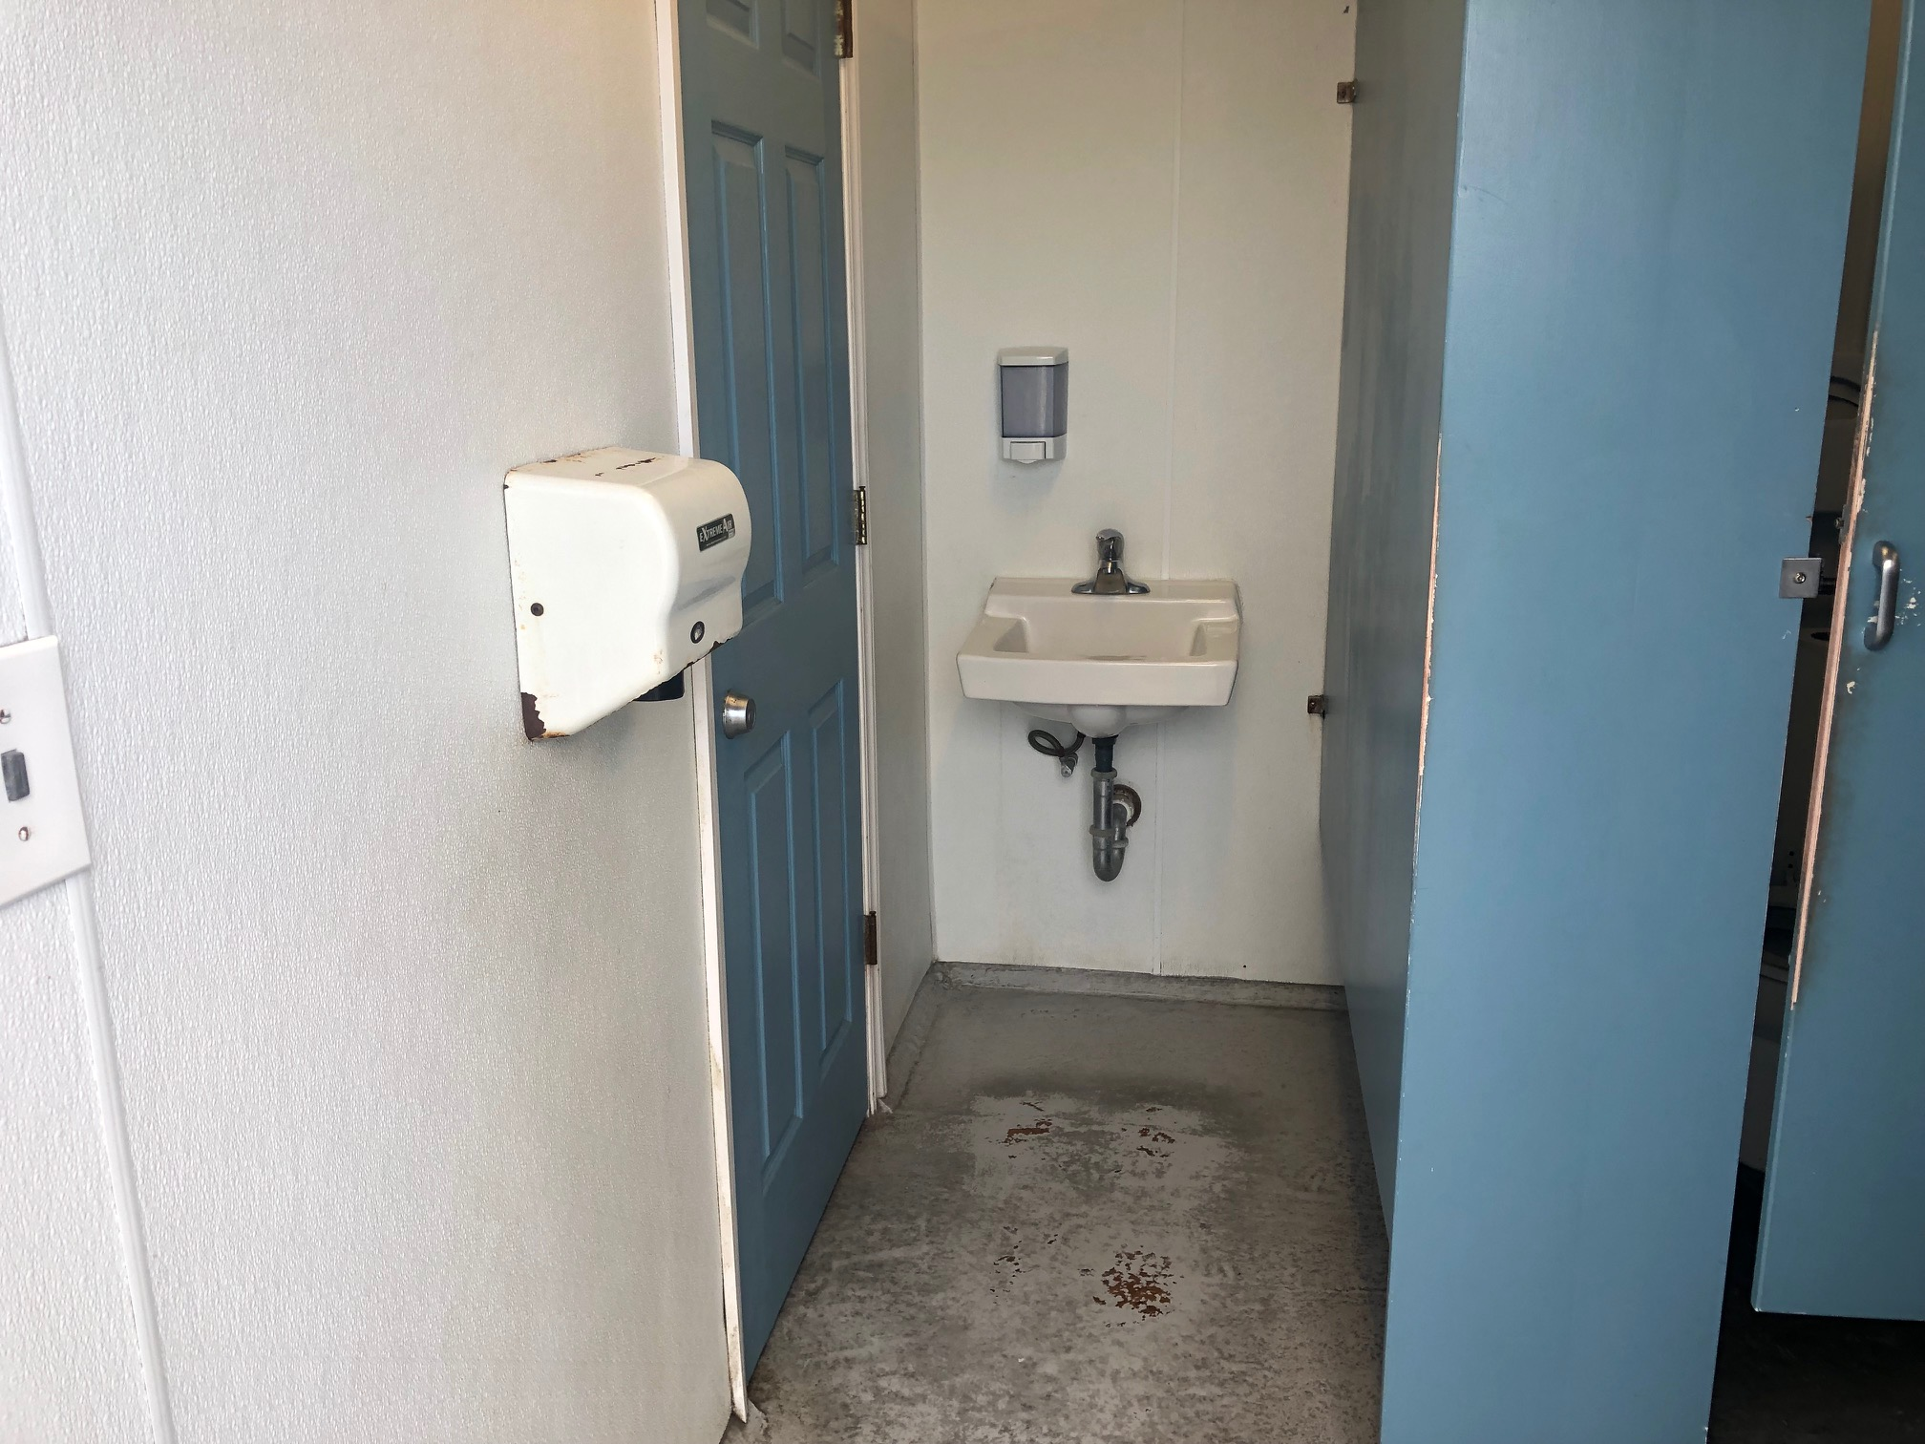
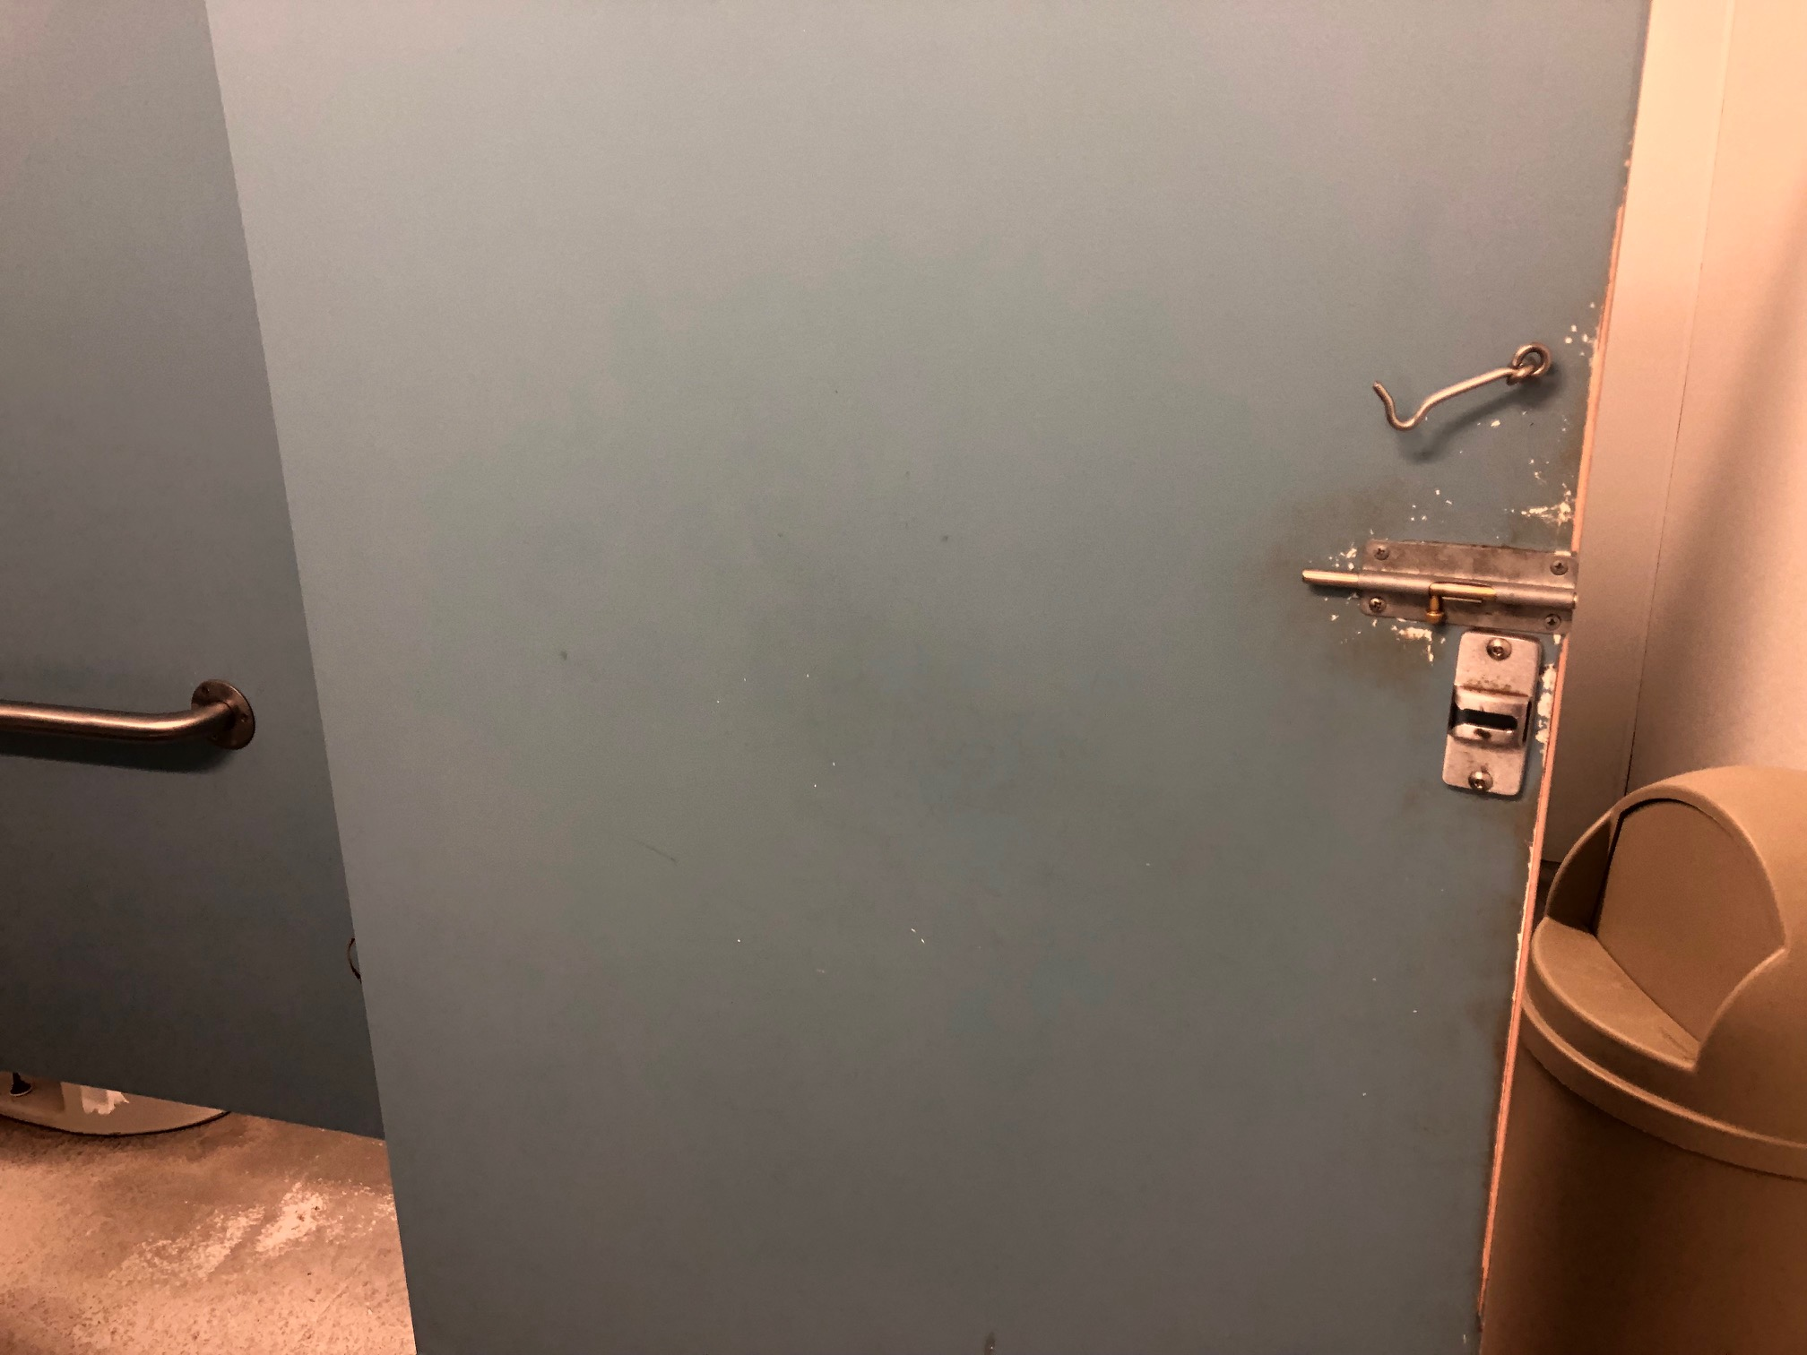
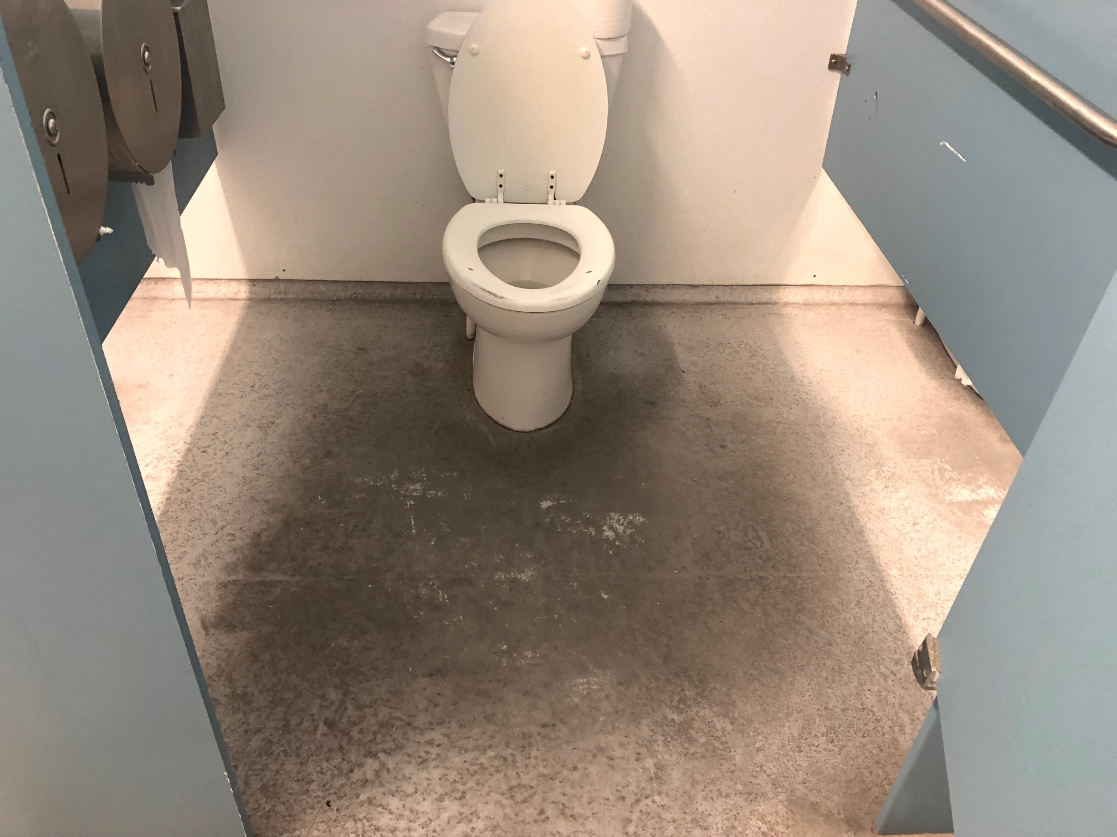
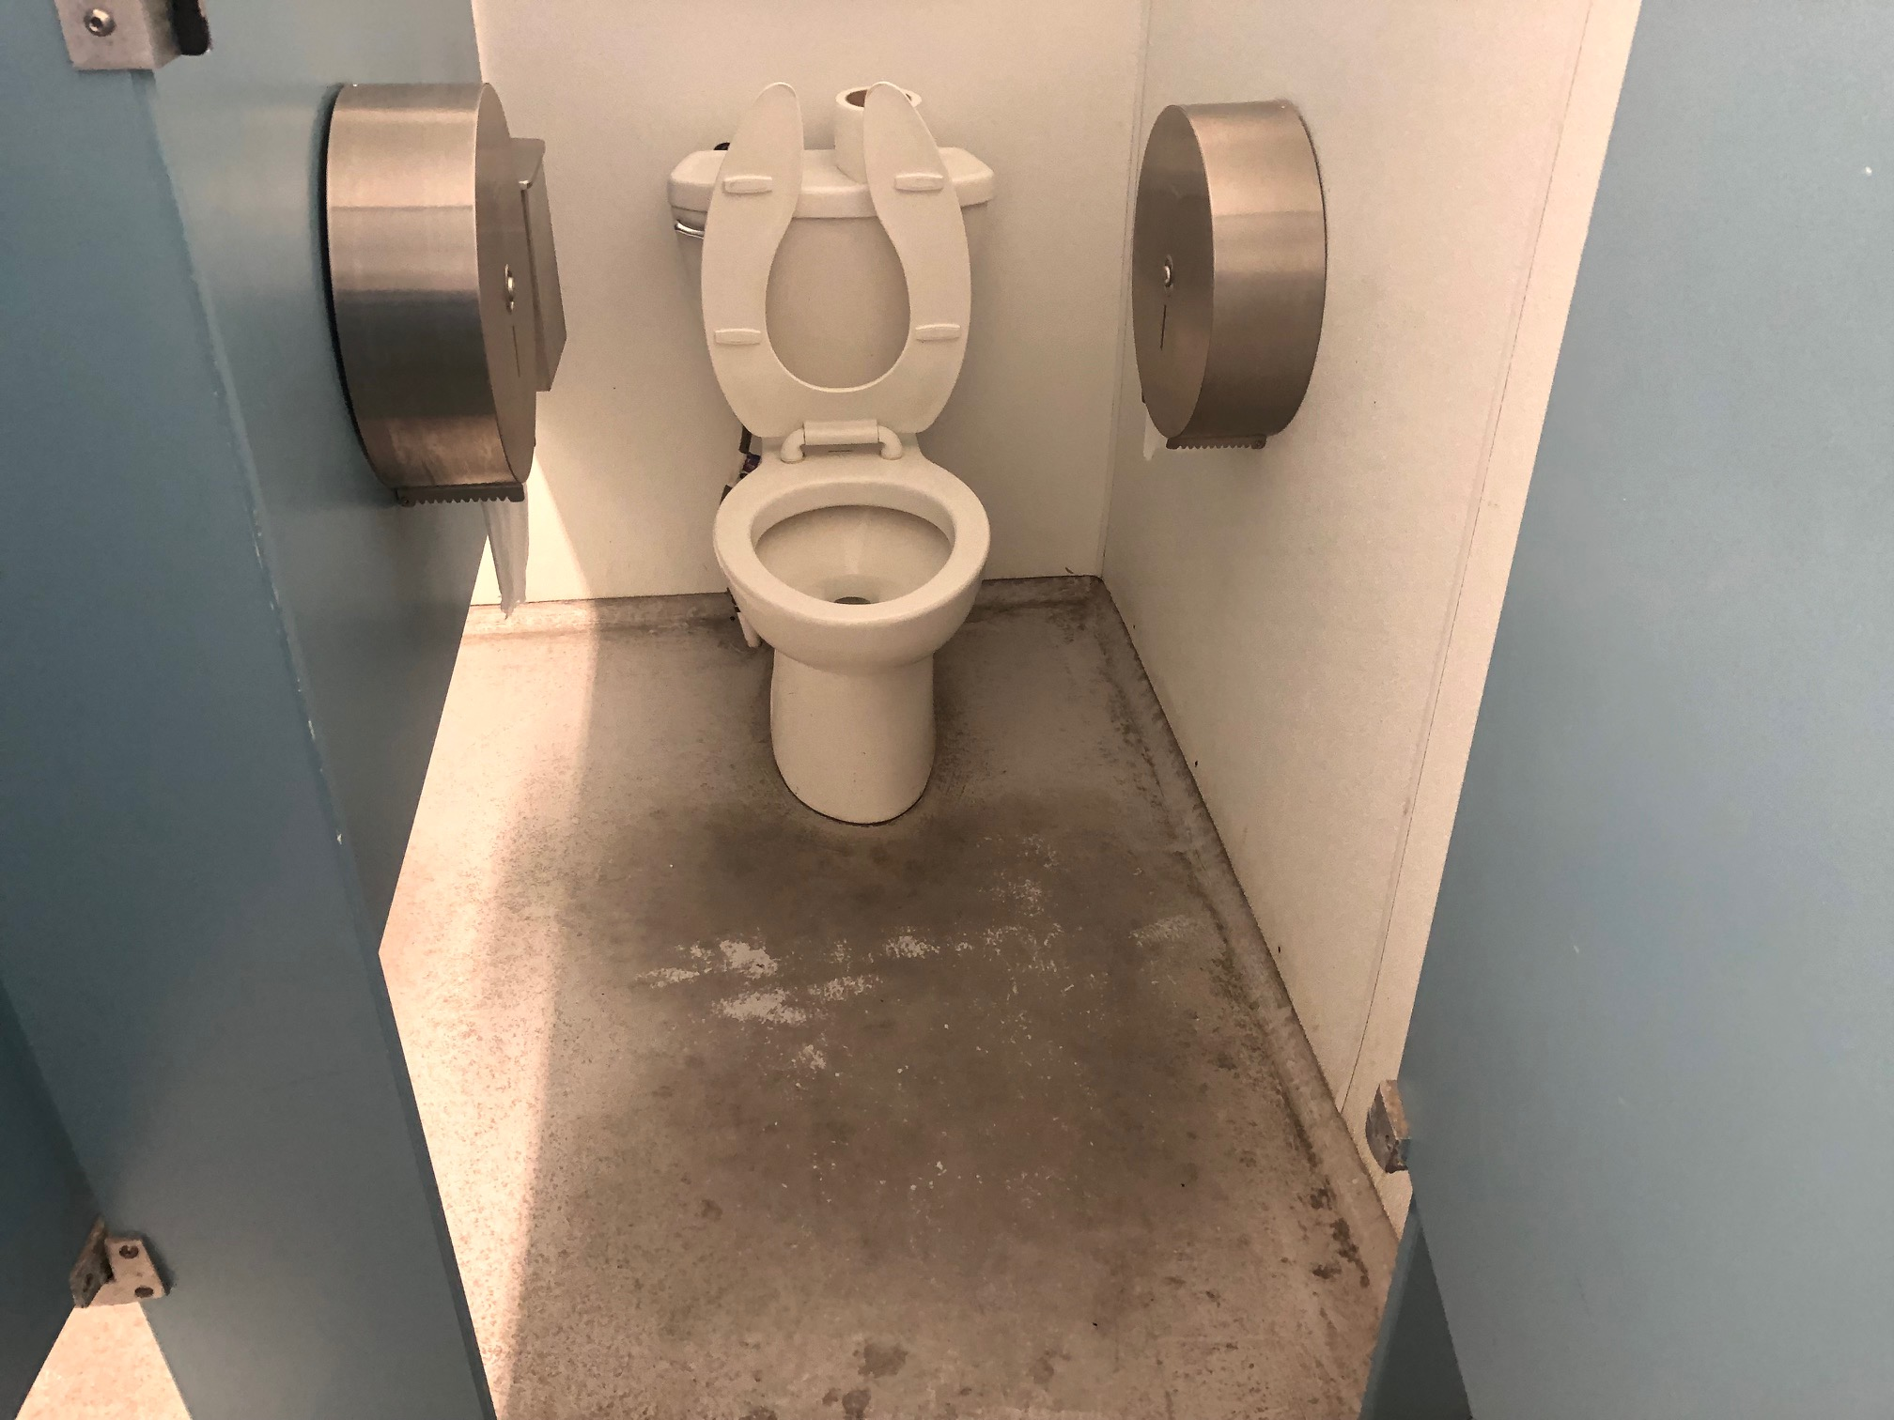
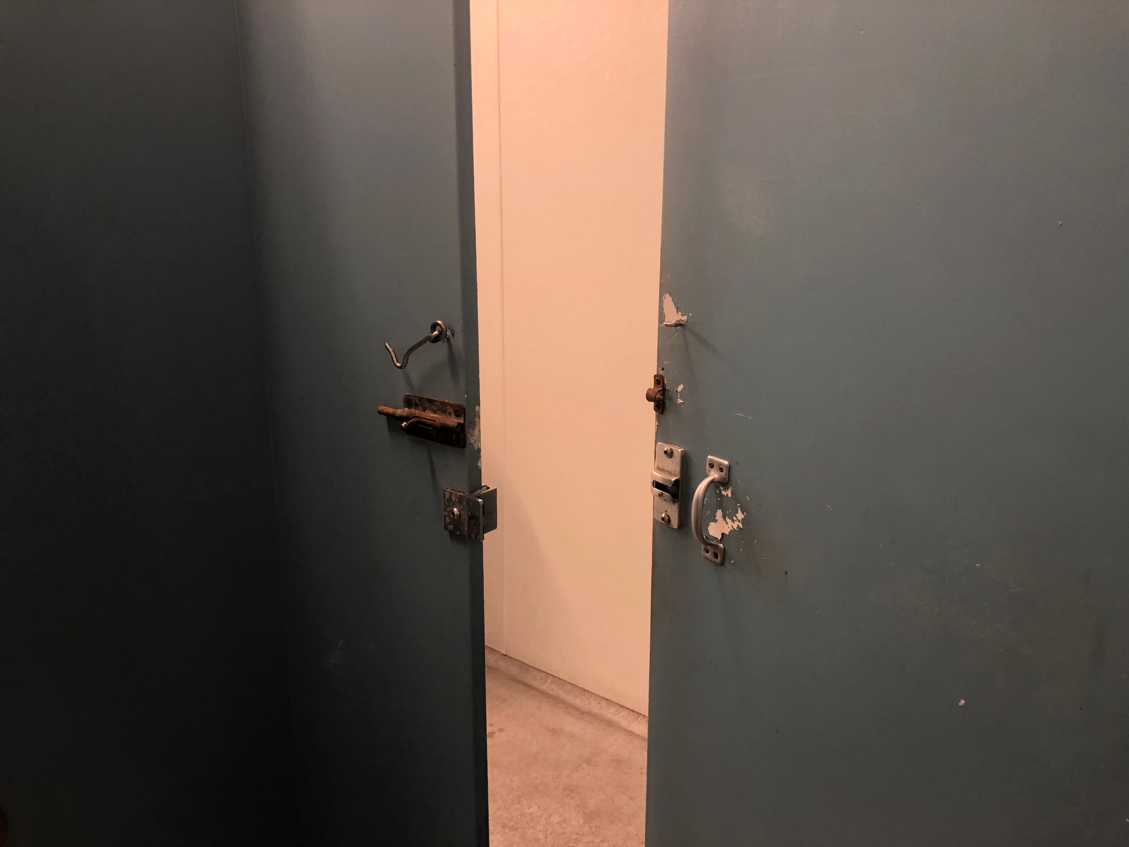
95th Street Restrooms INTERIOR

Slide 8
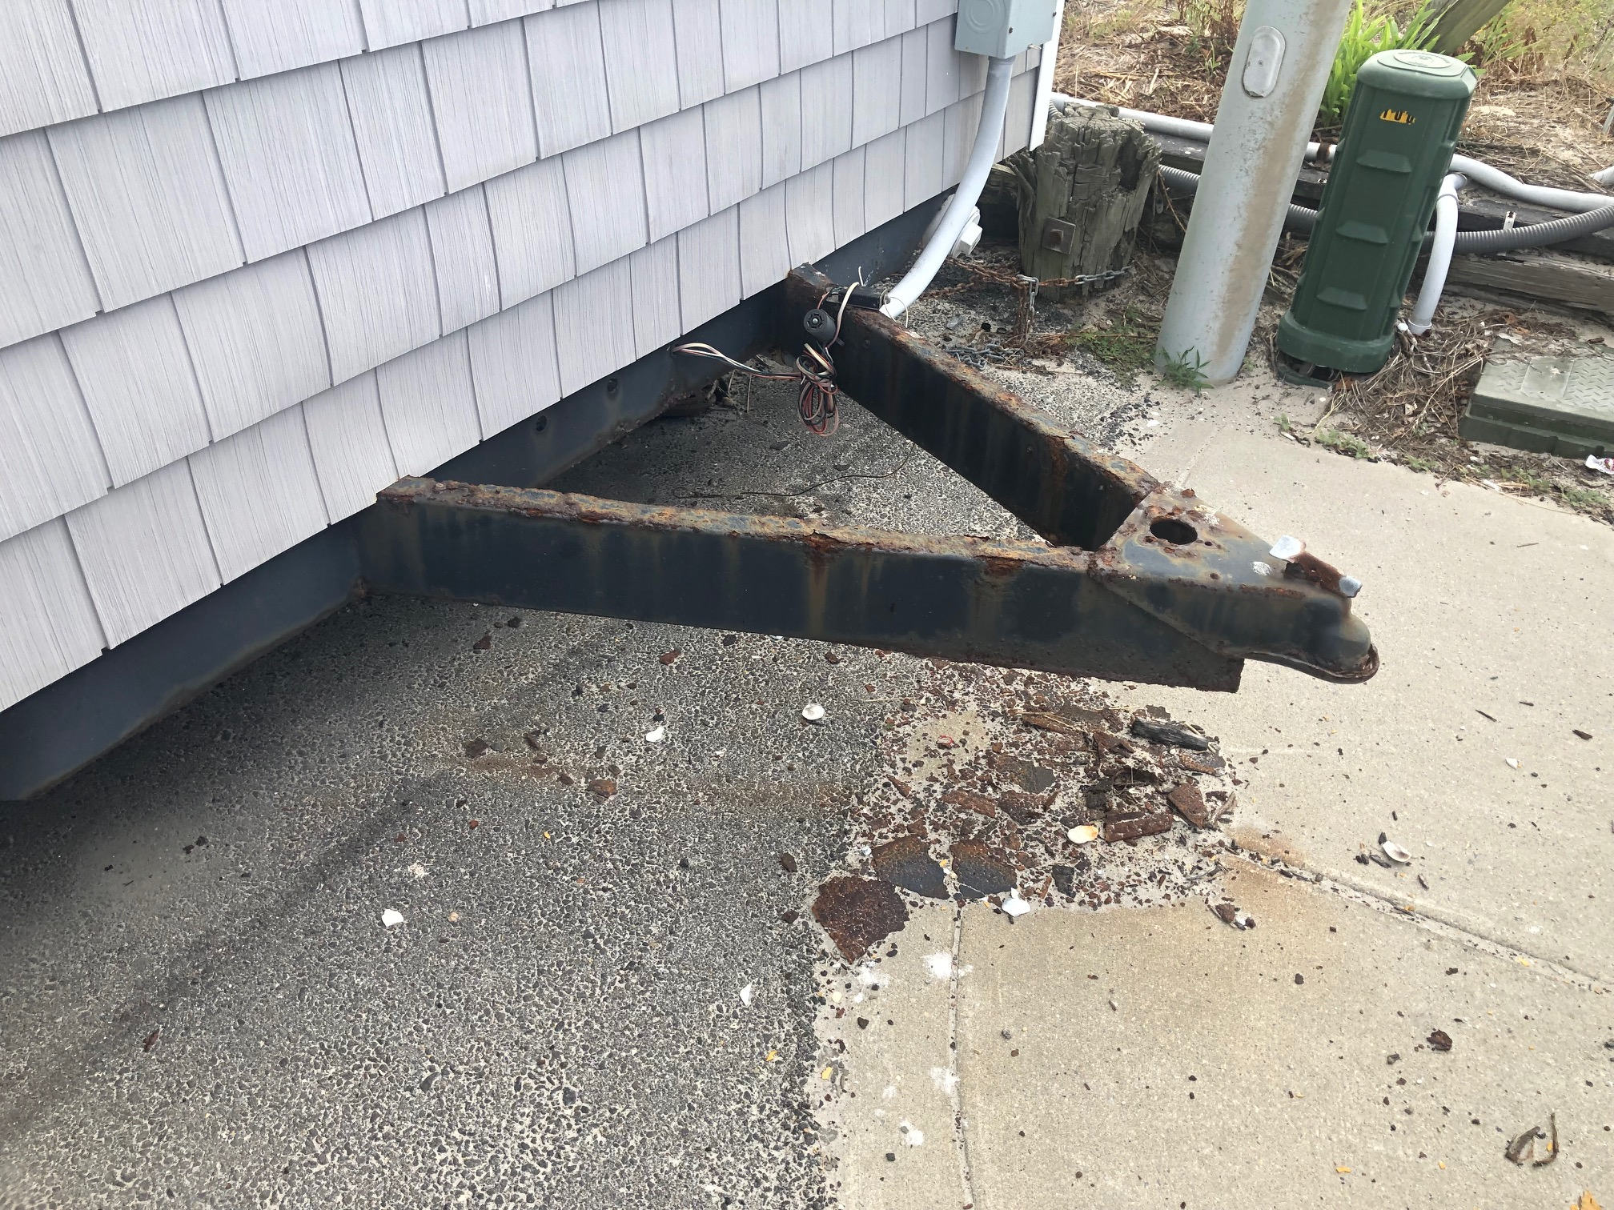
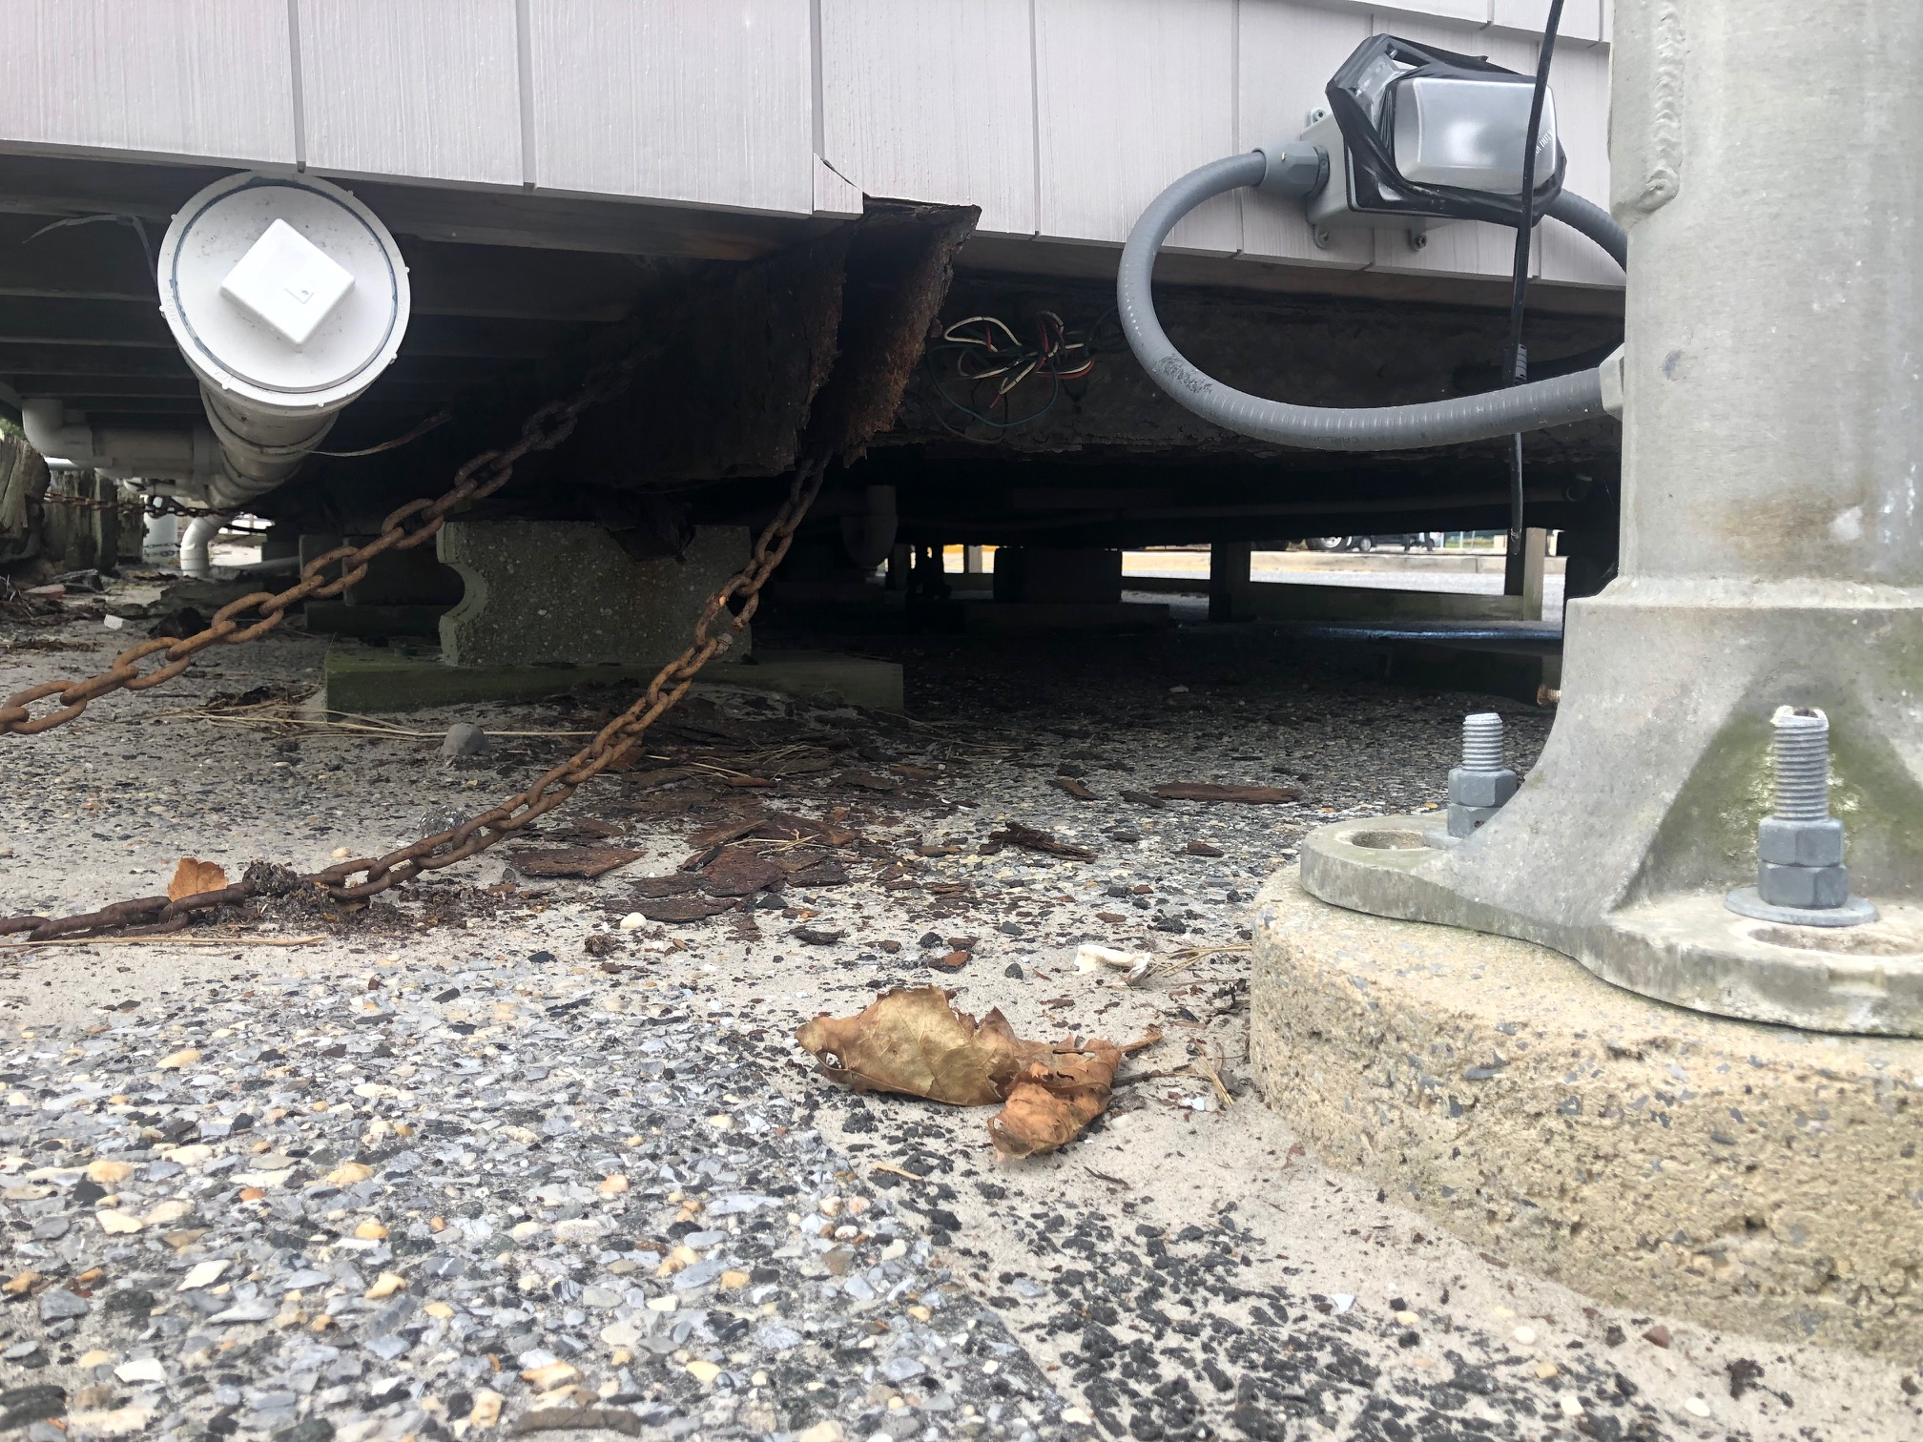
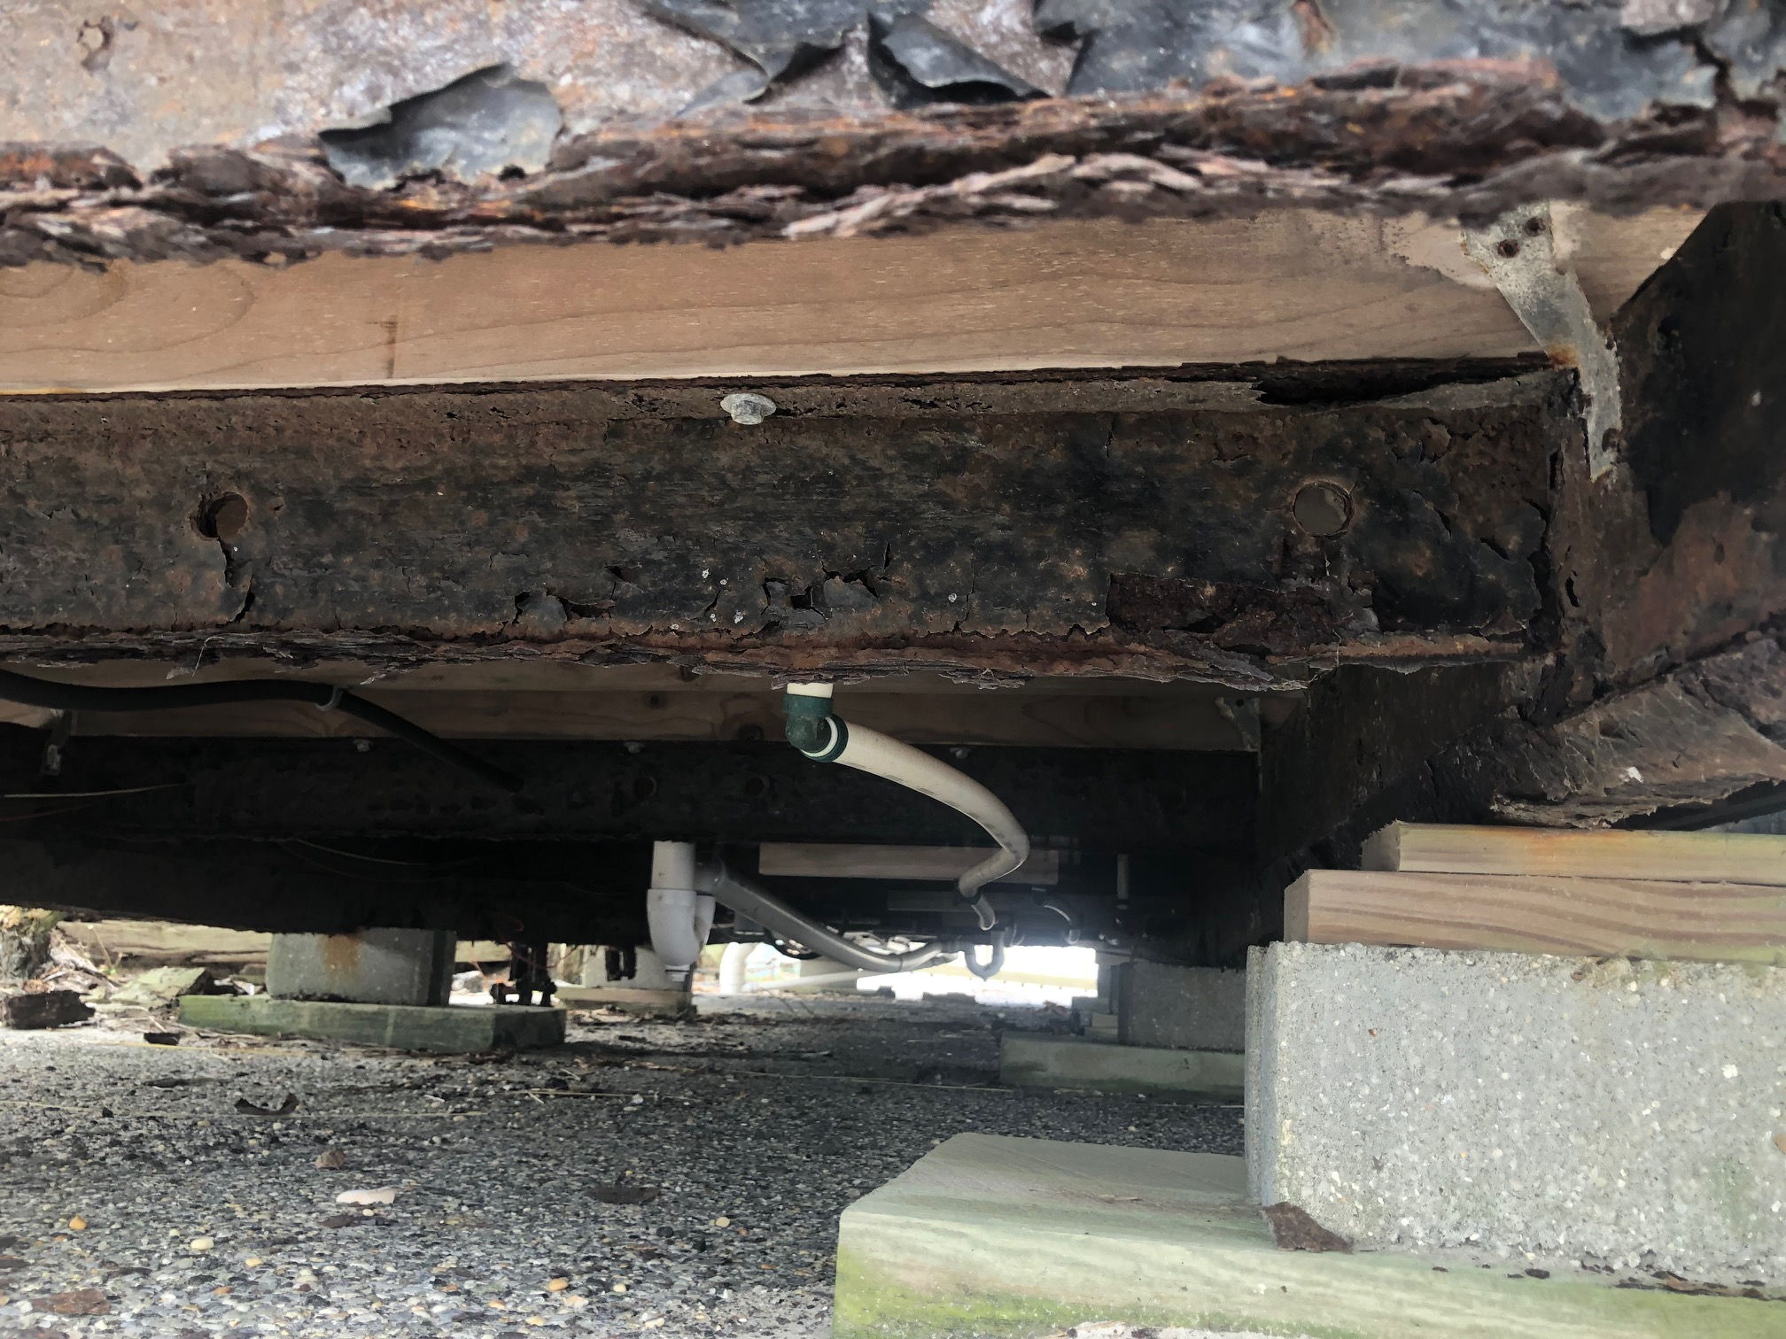
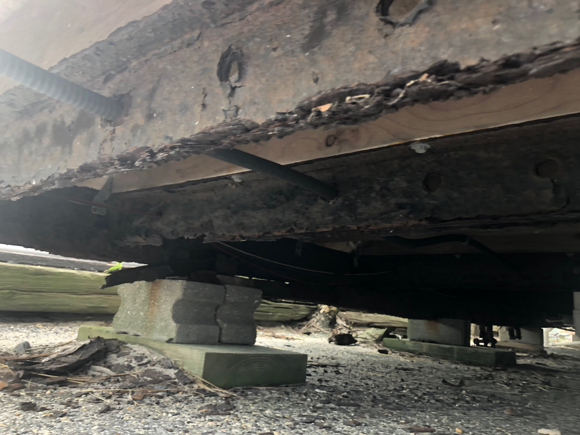
95th Street Restrooms EXTERIOR

Slide 9
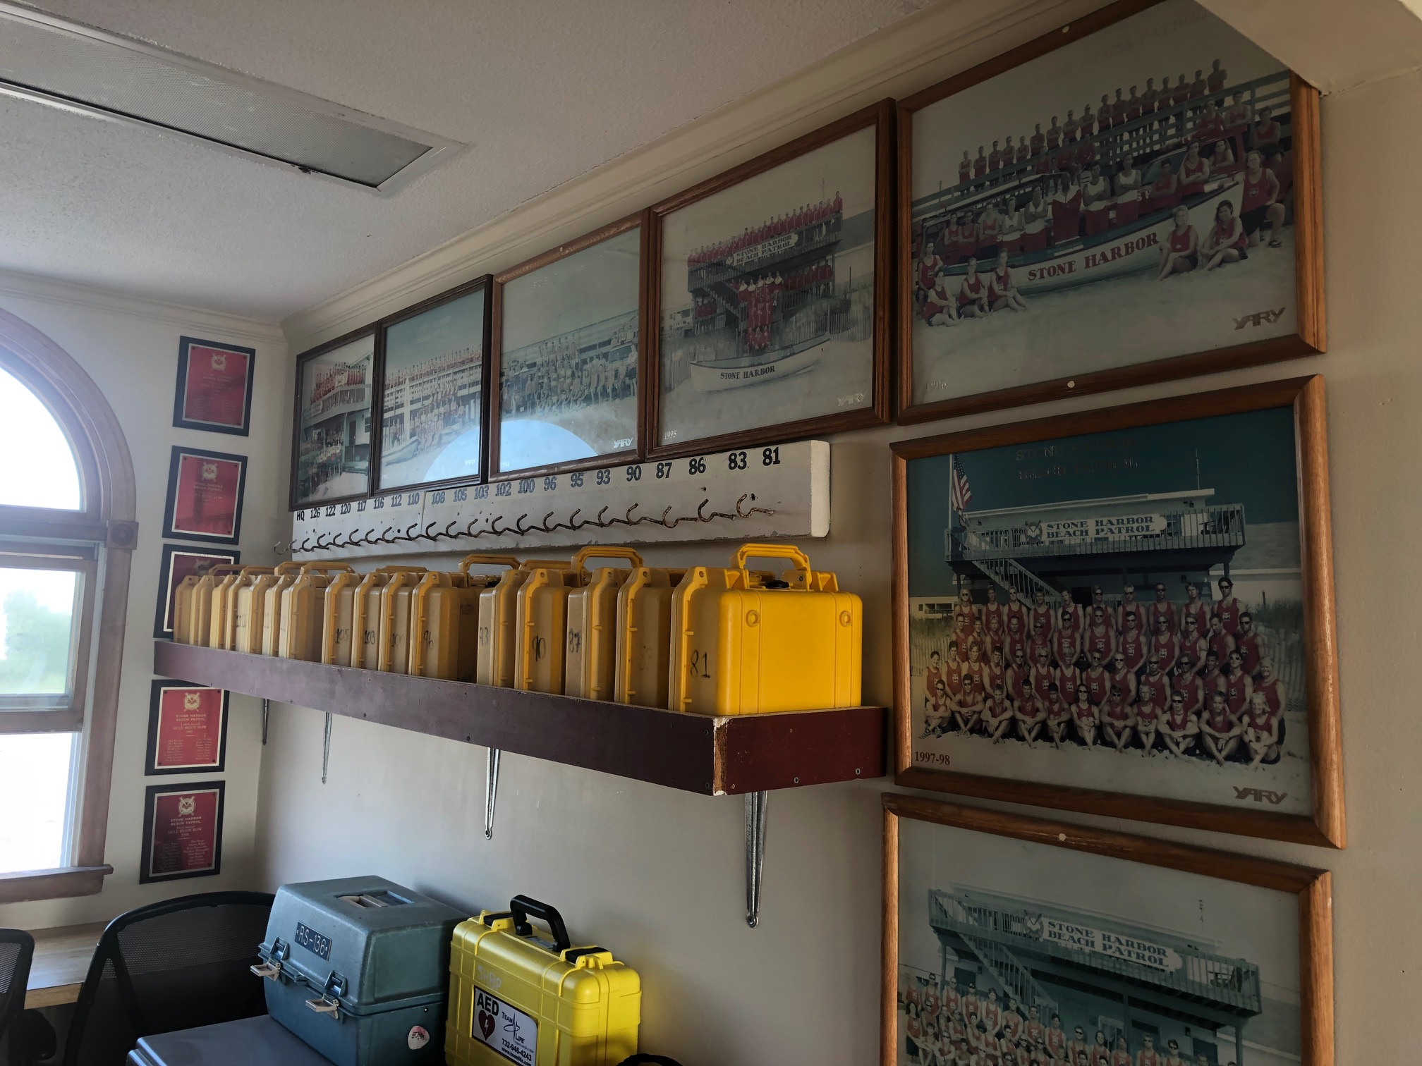
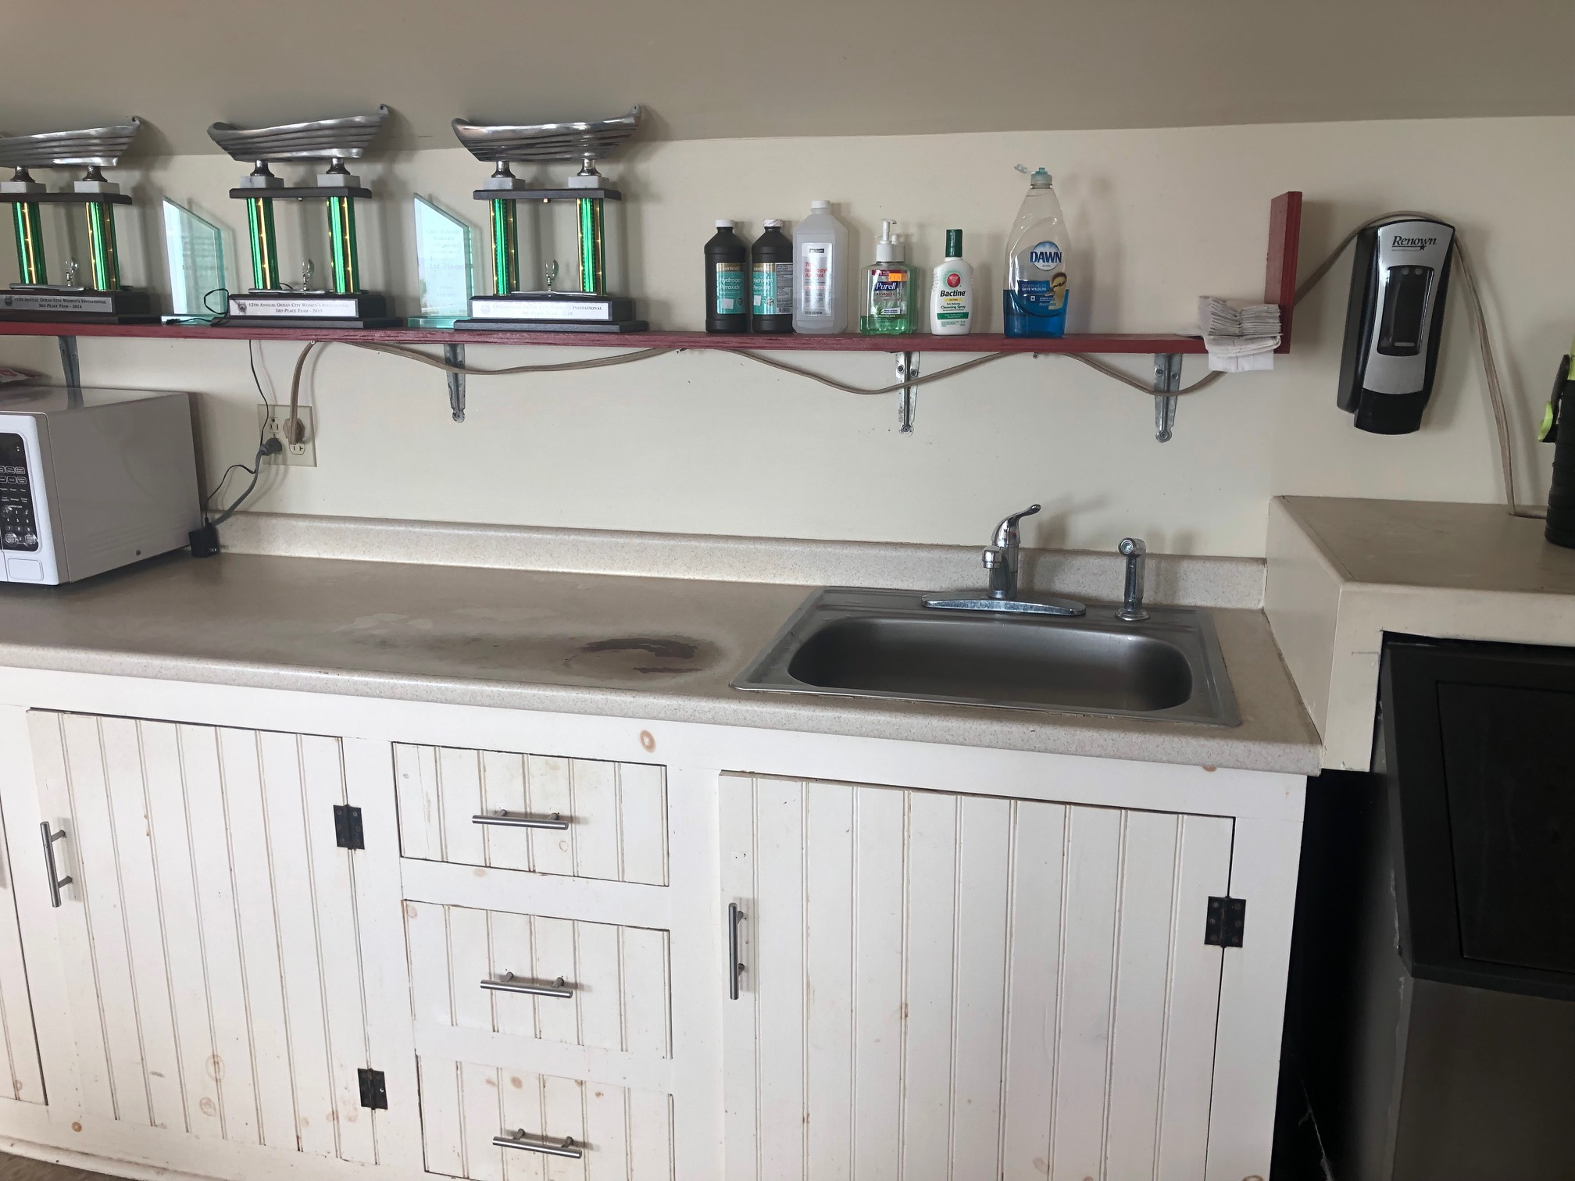
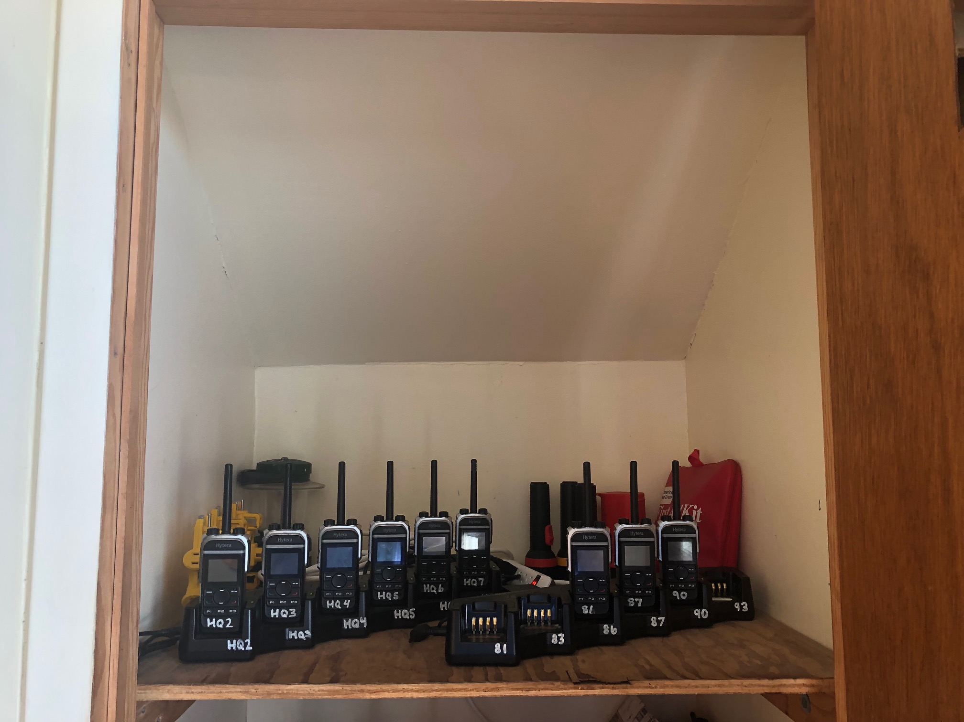
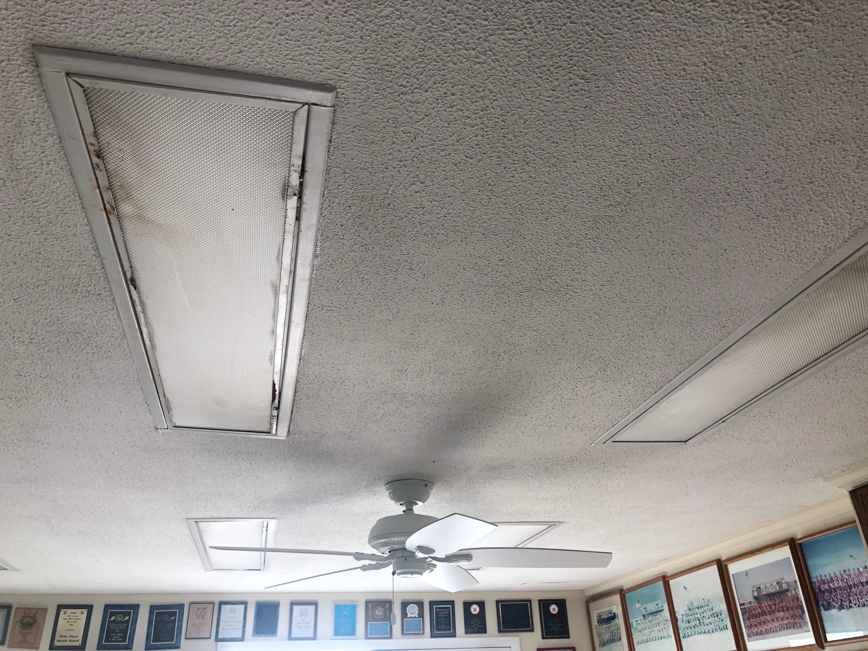
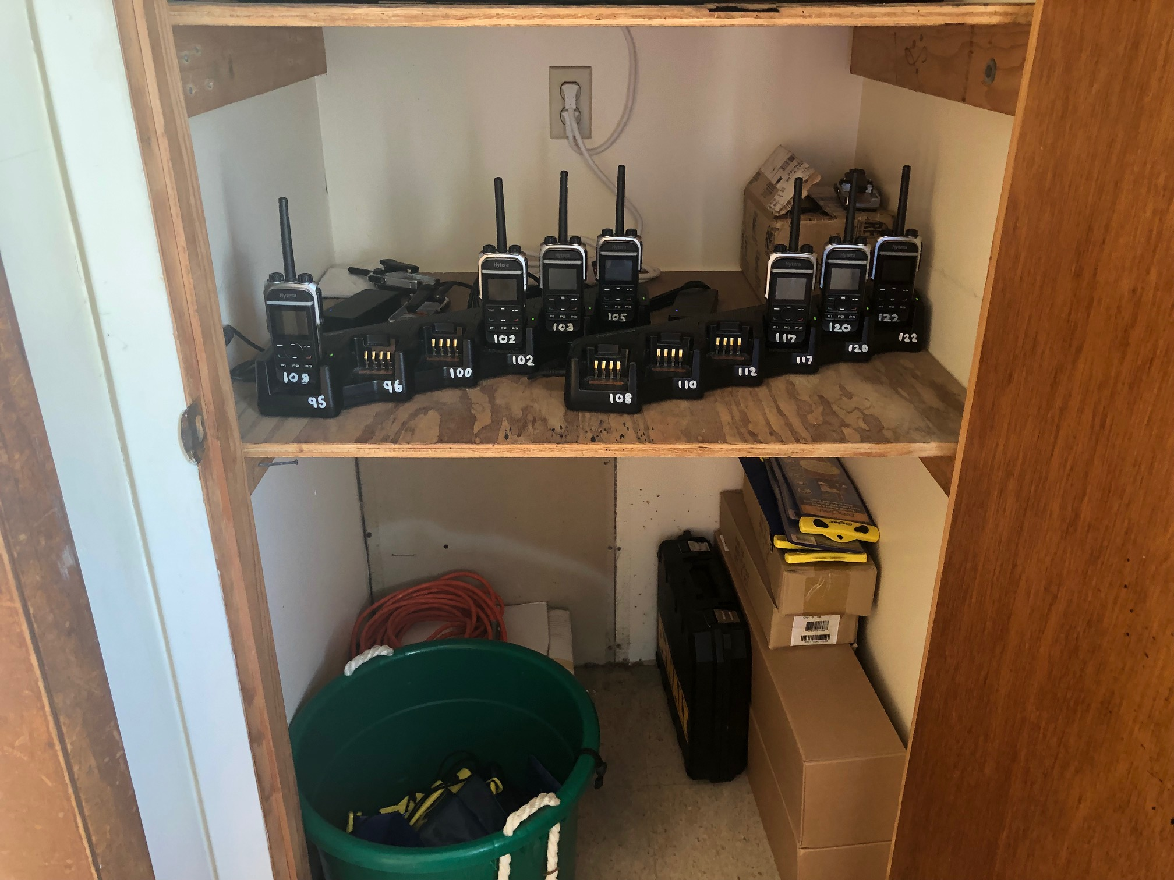
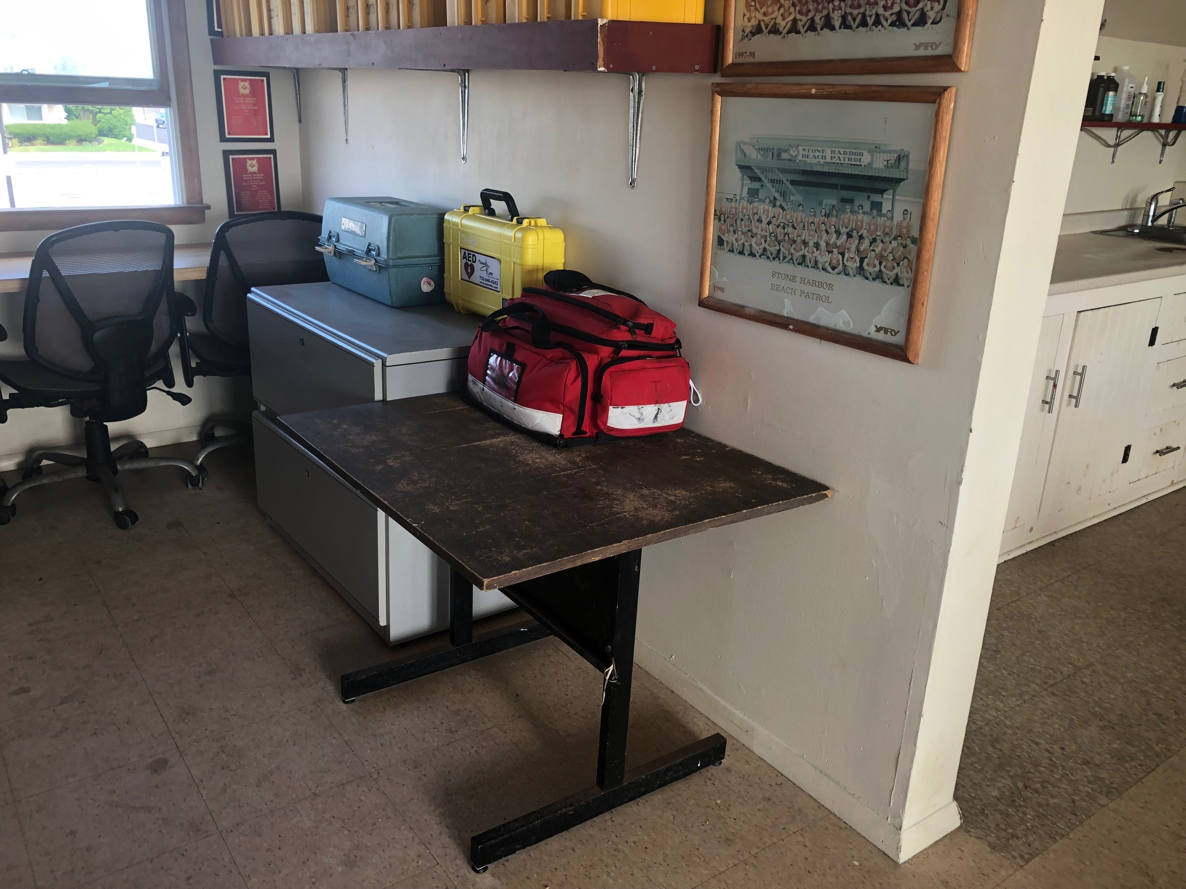
SHBP Headquarters SECOND FLOOR

Slide 10
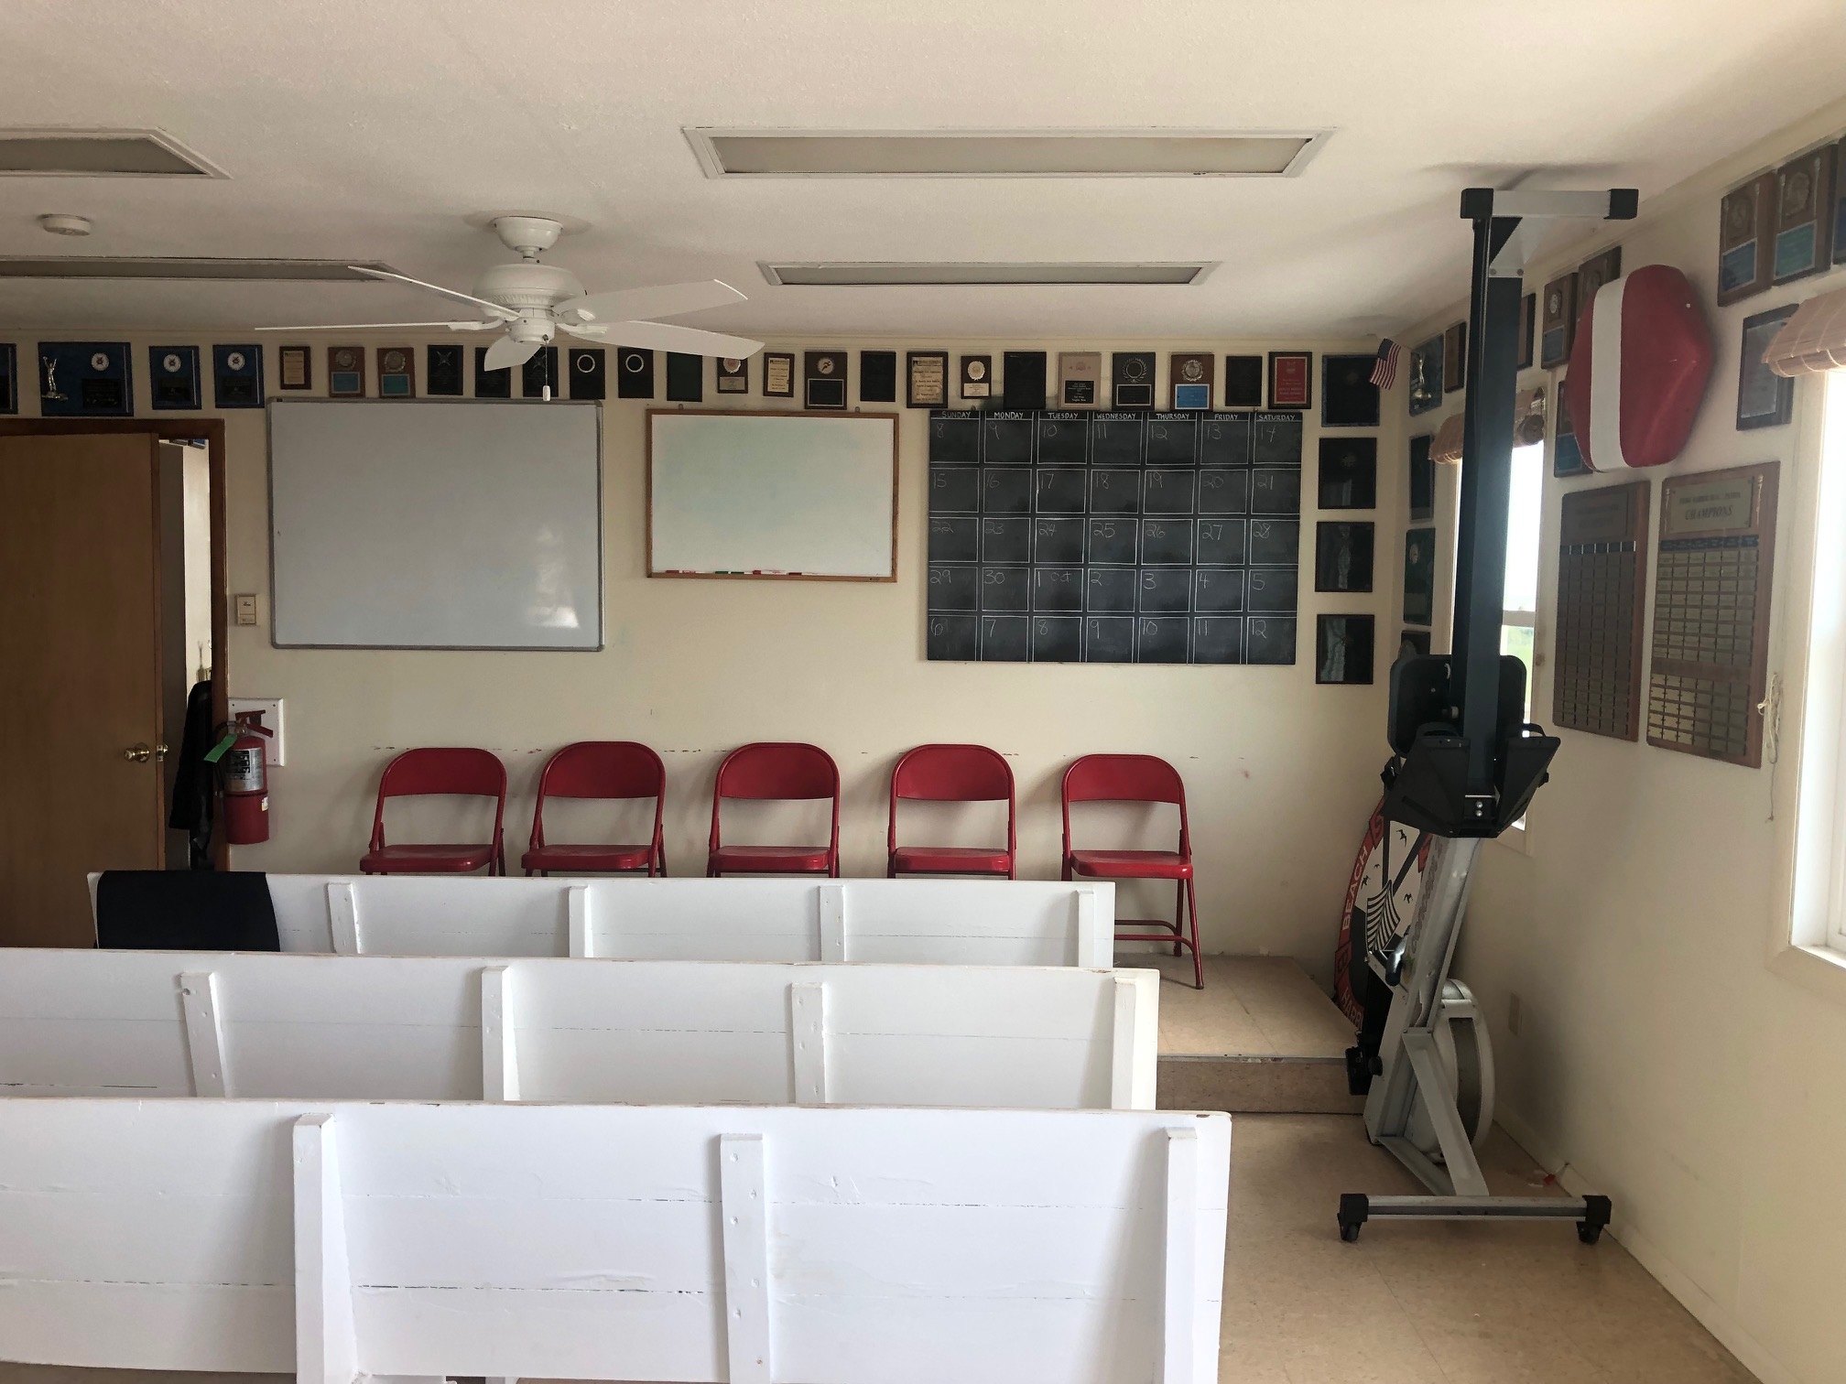
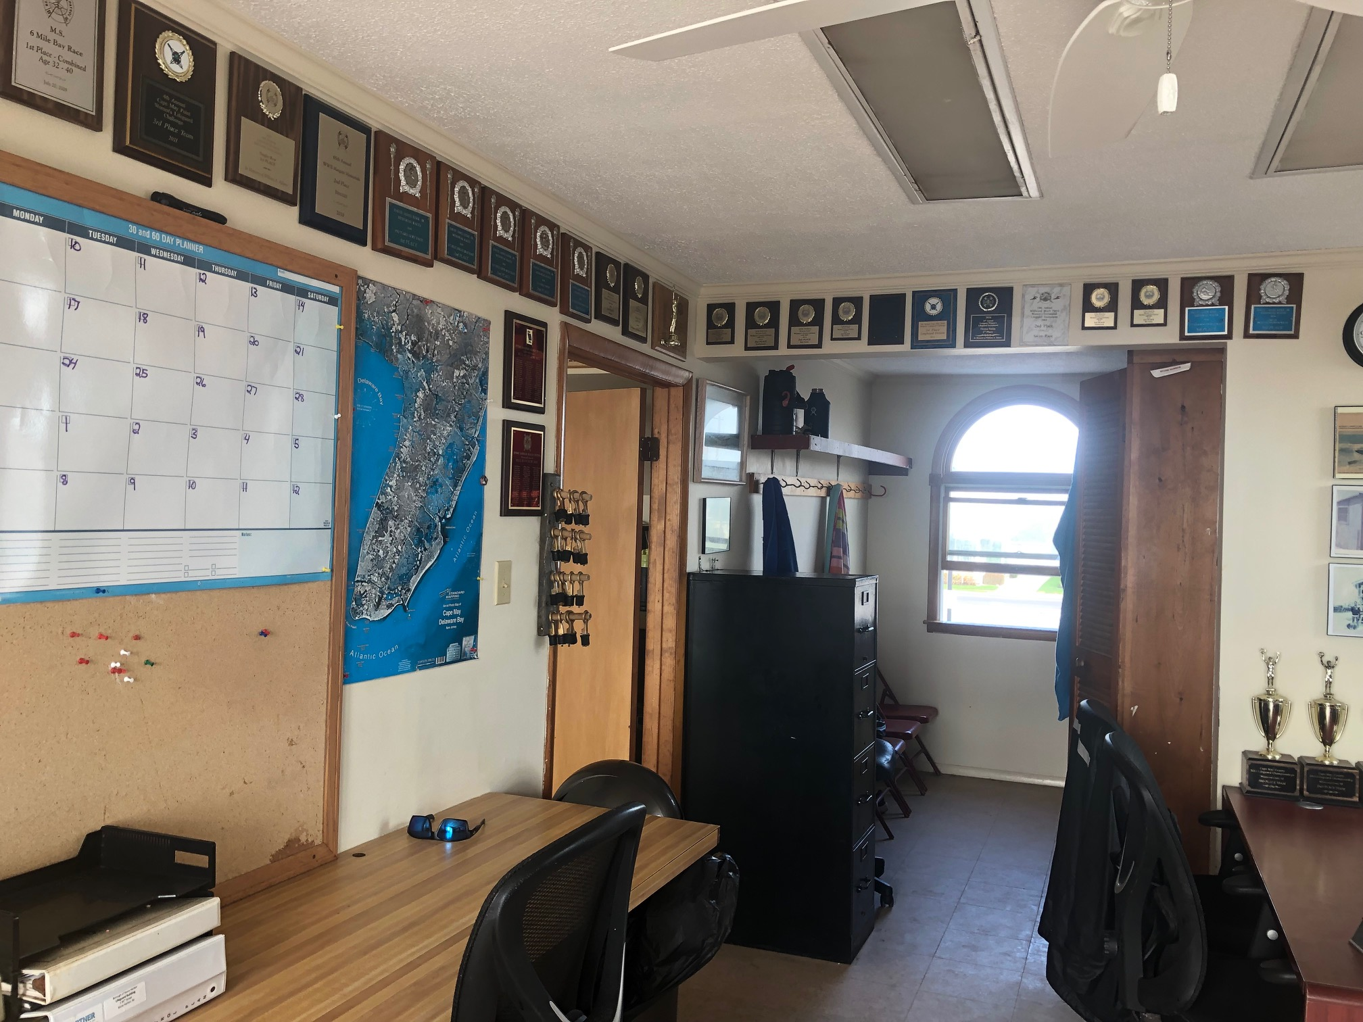
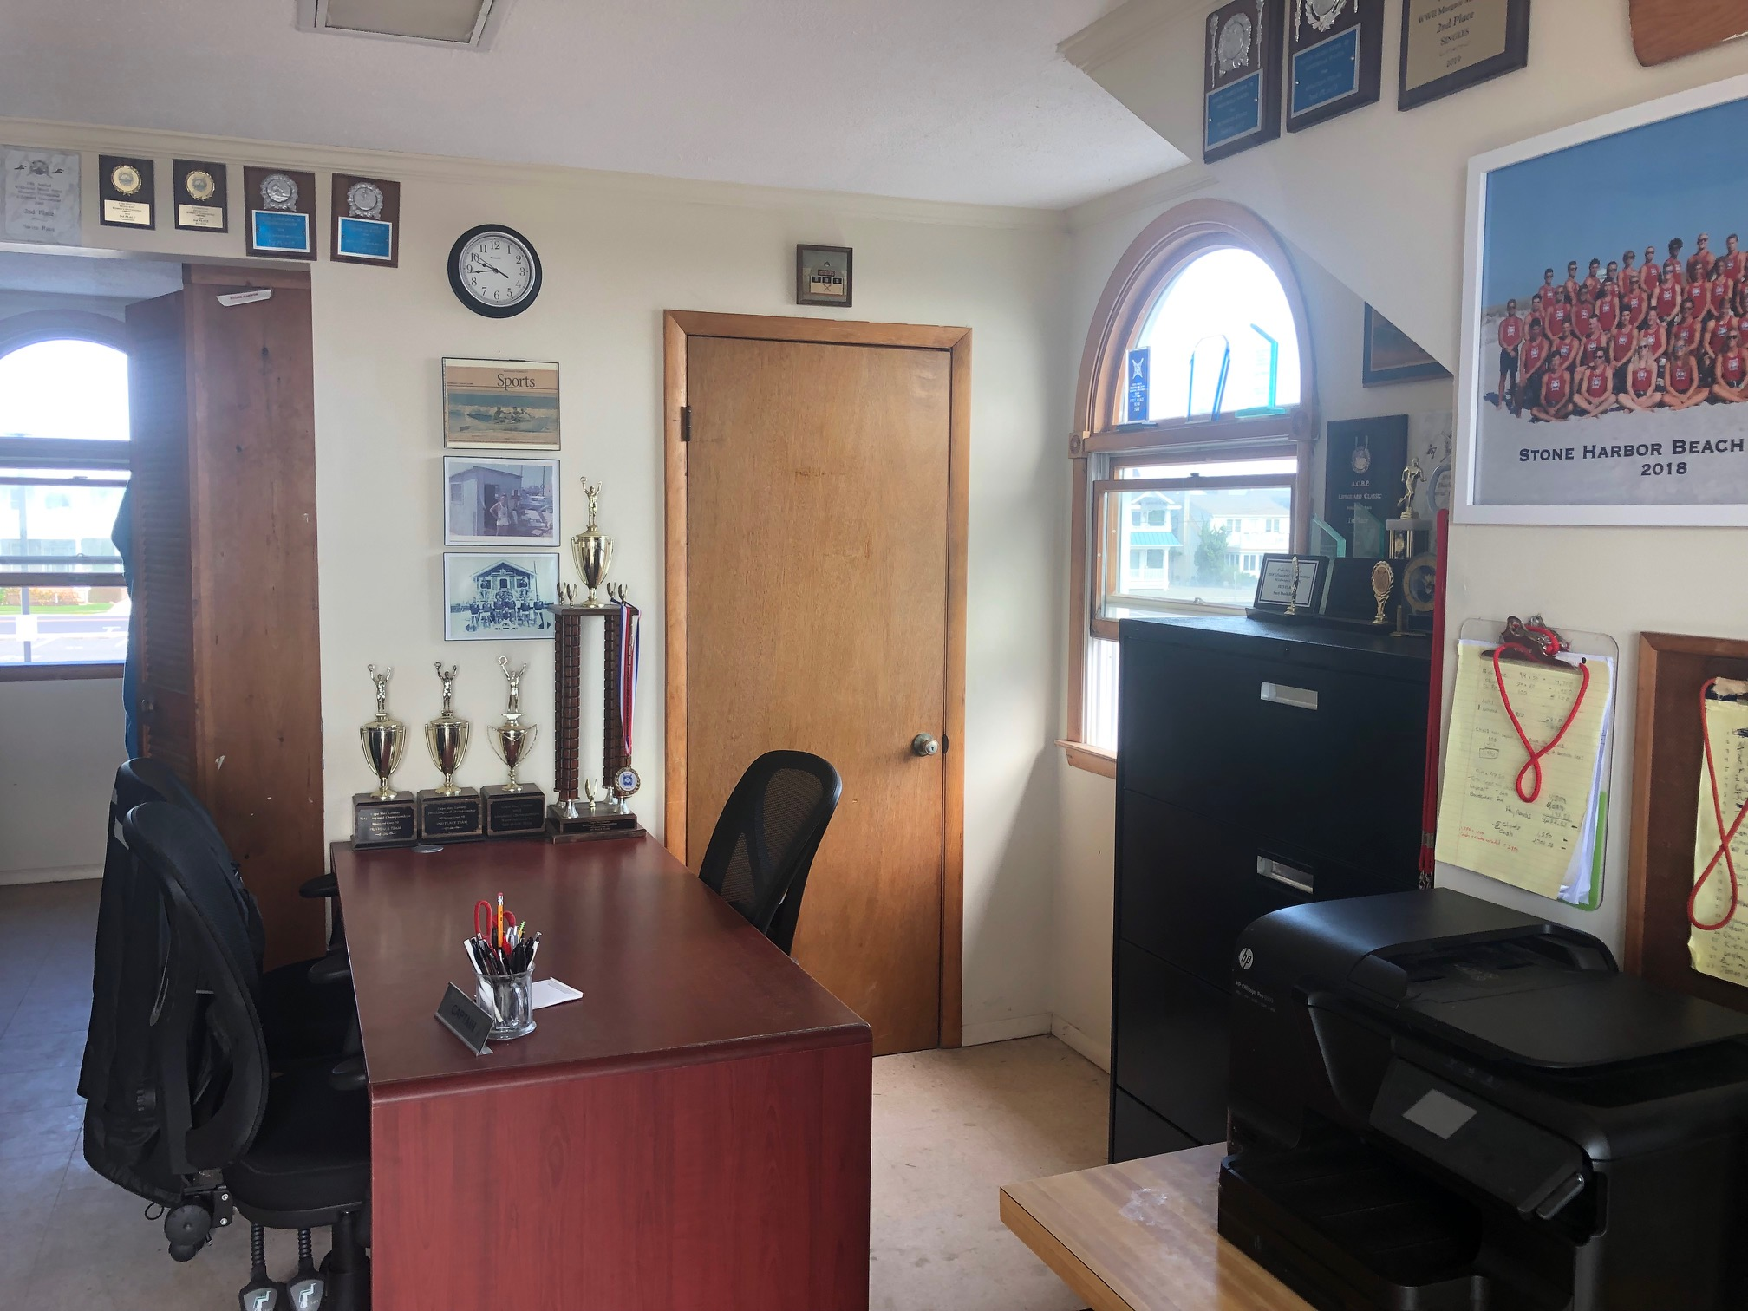
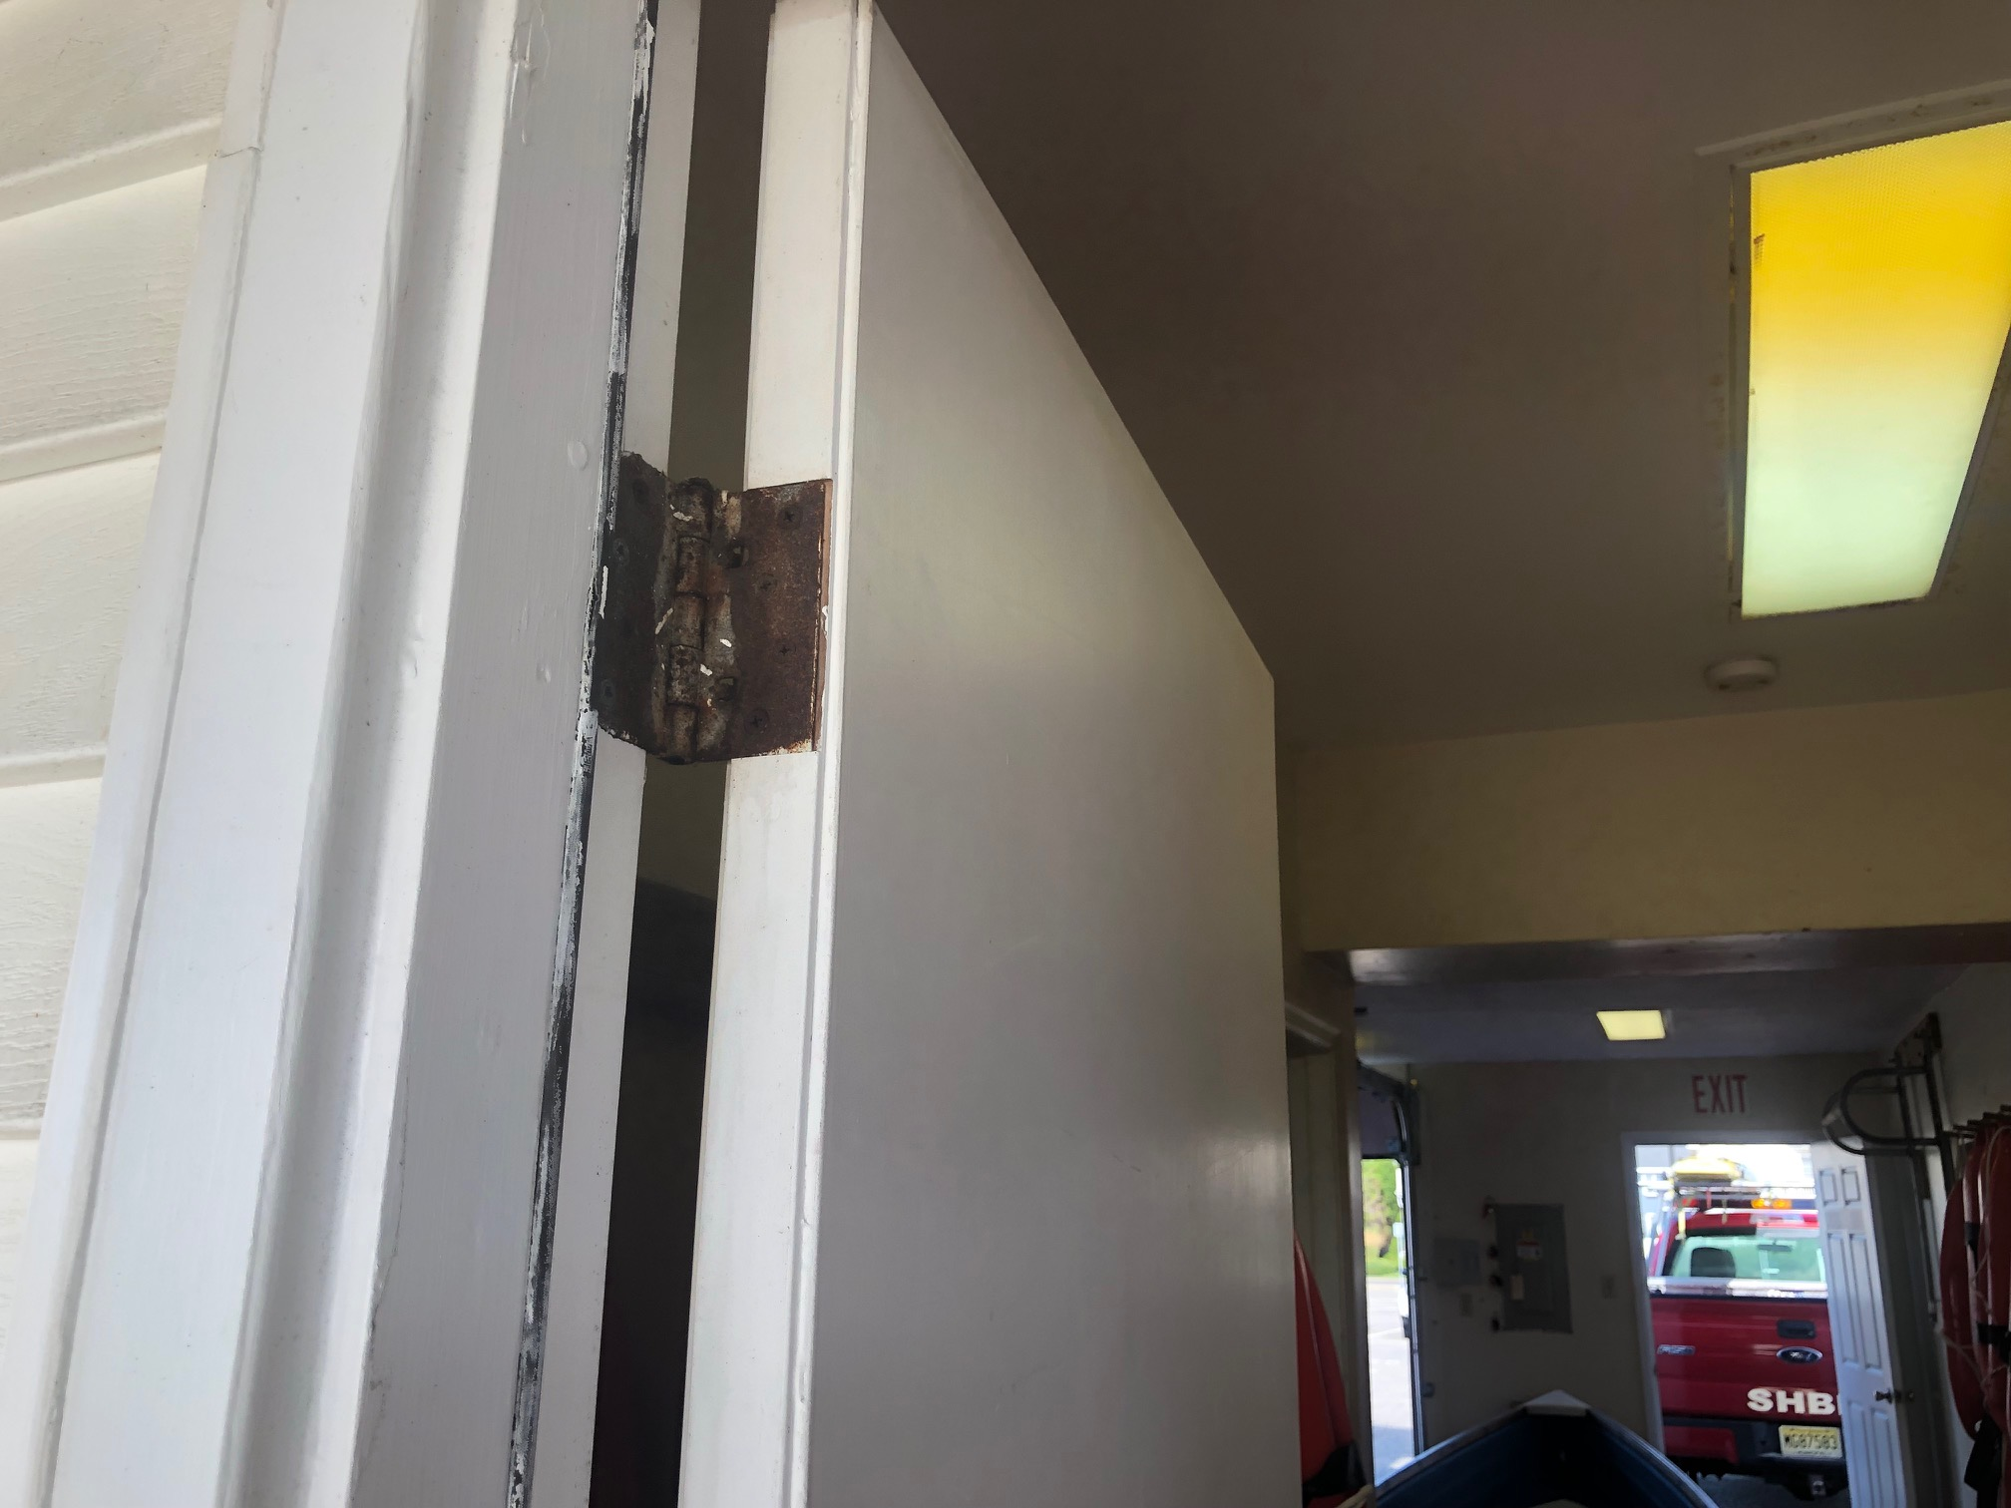
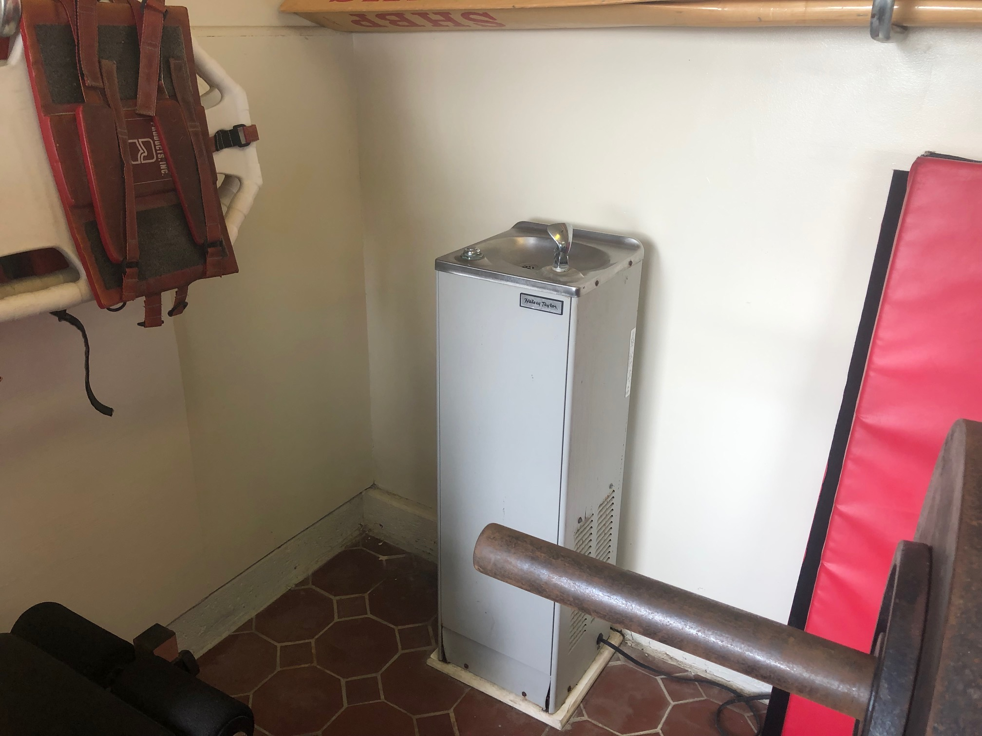
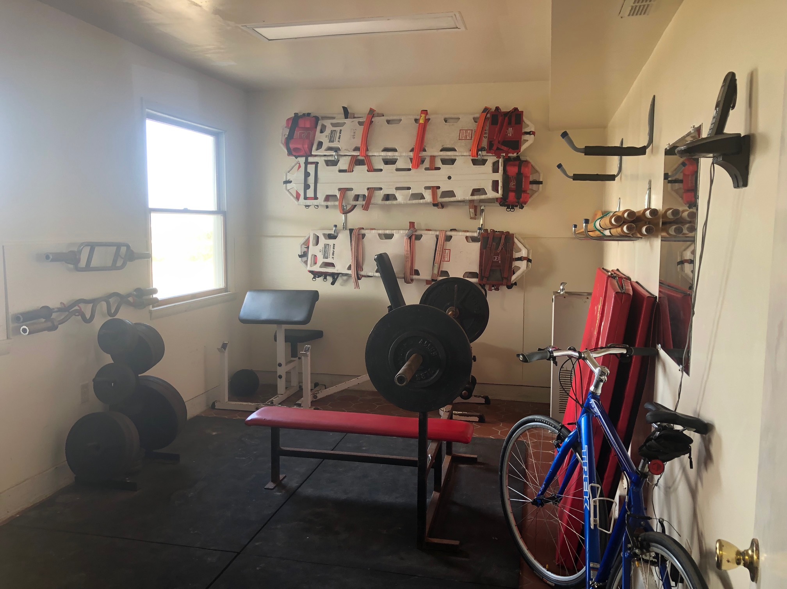
SHBP Headquarters SECOND FLOOR & FIRST FLOOR

Slide 11
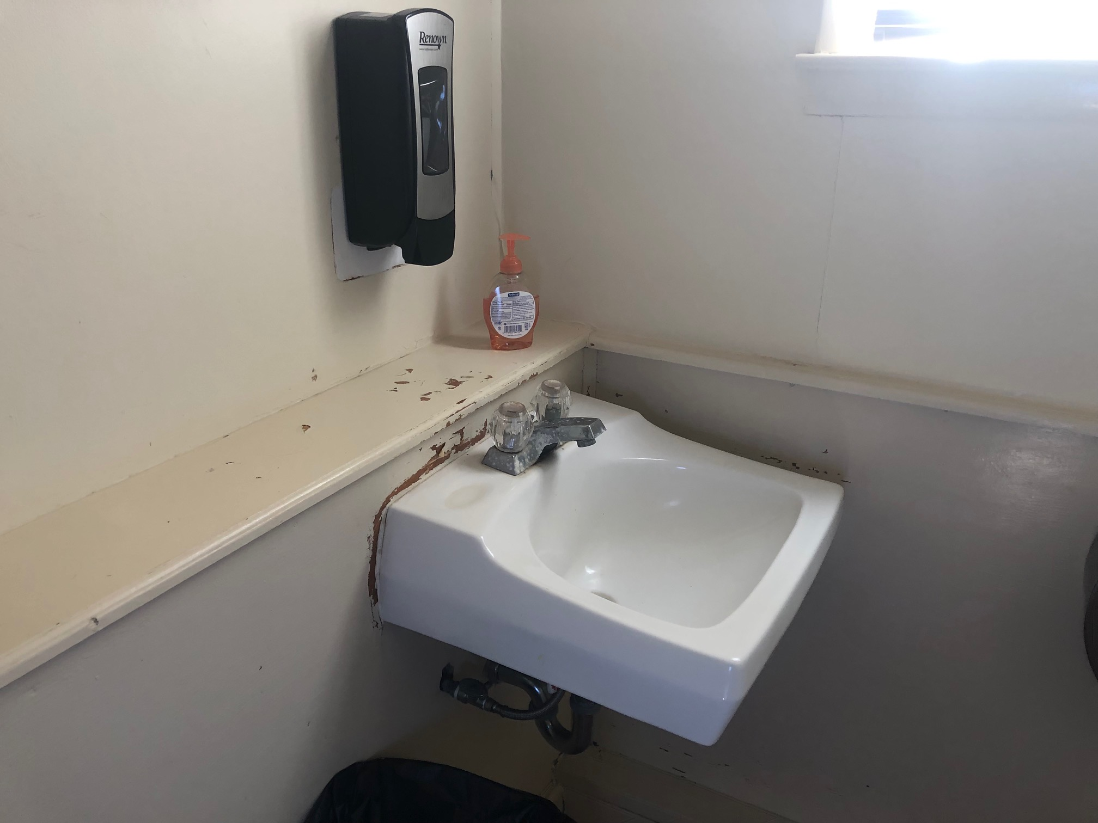
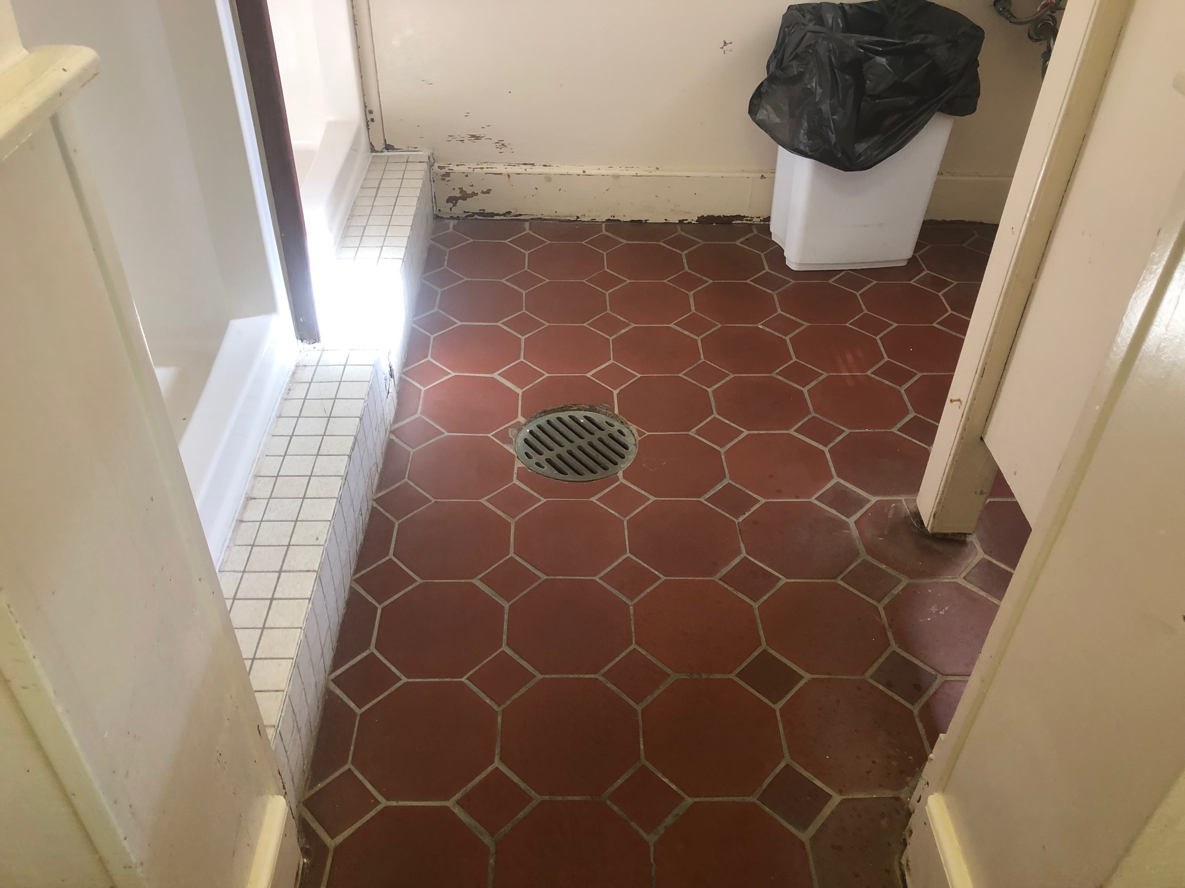
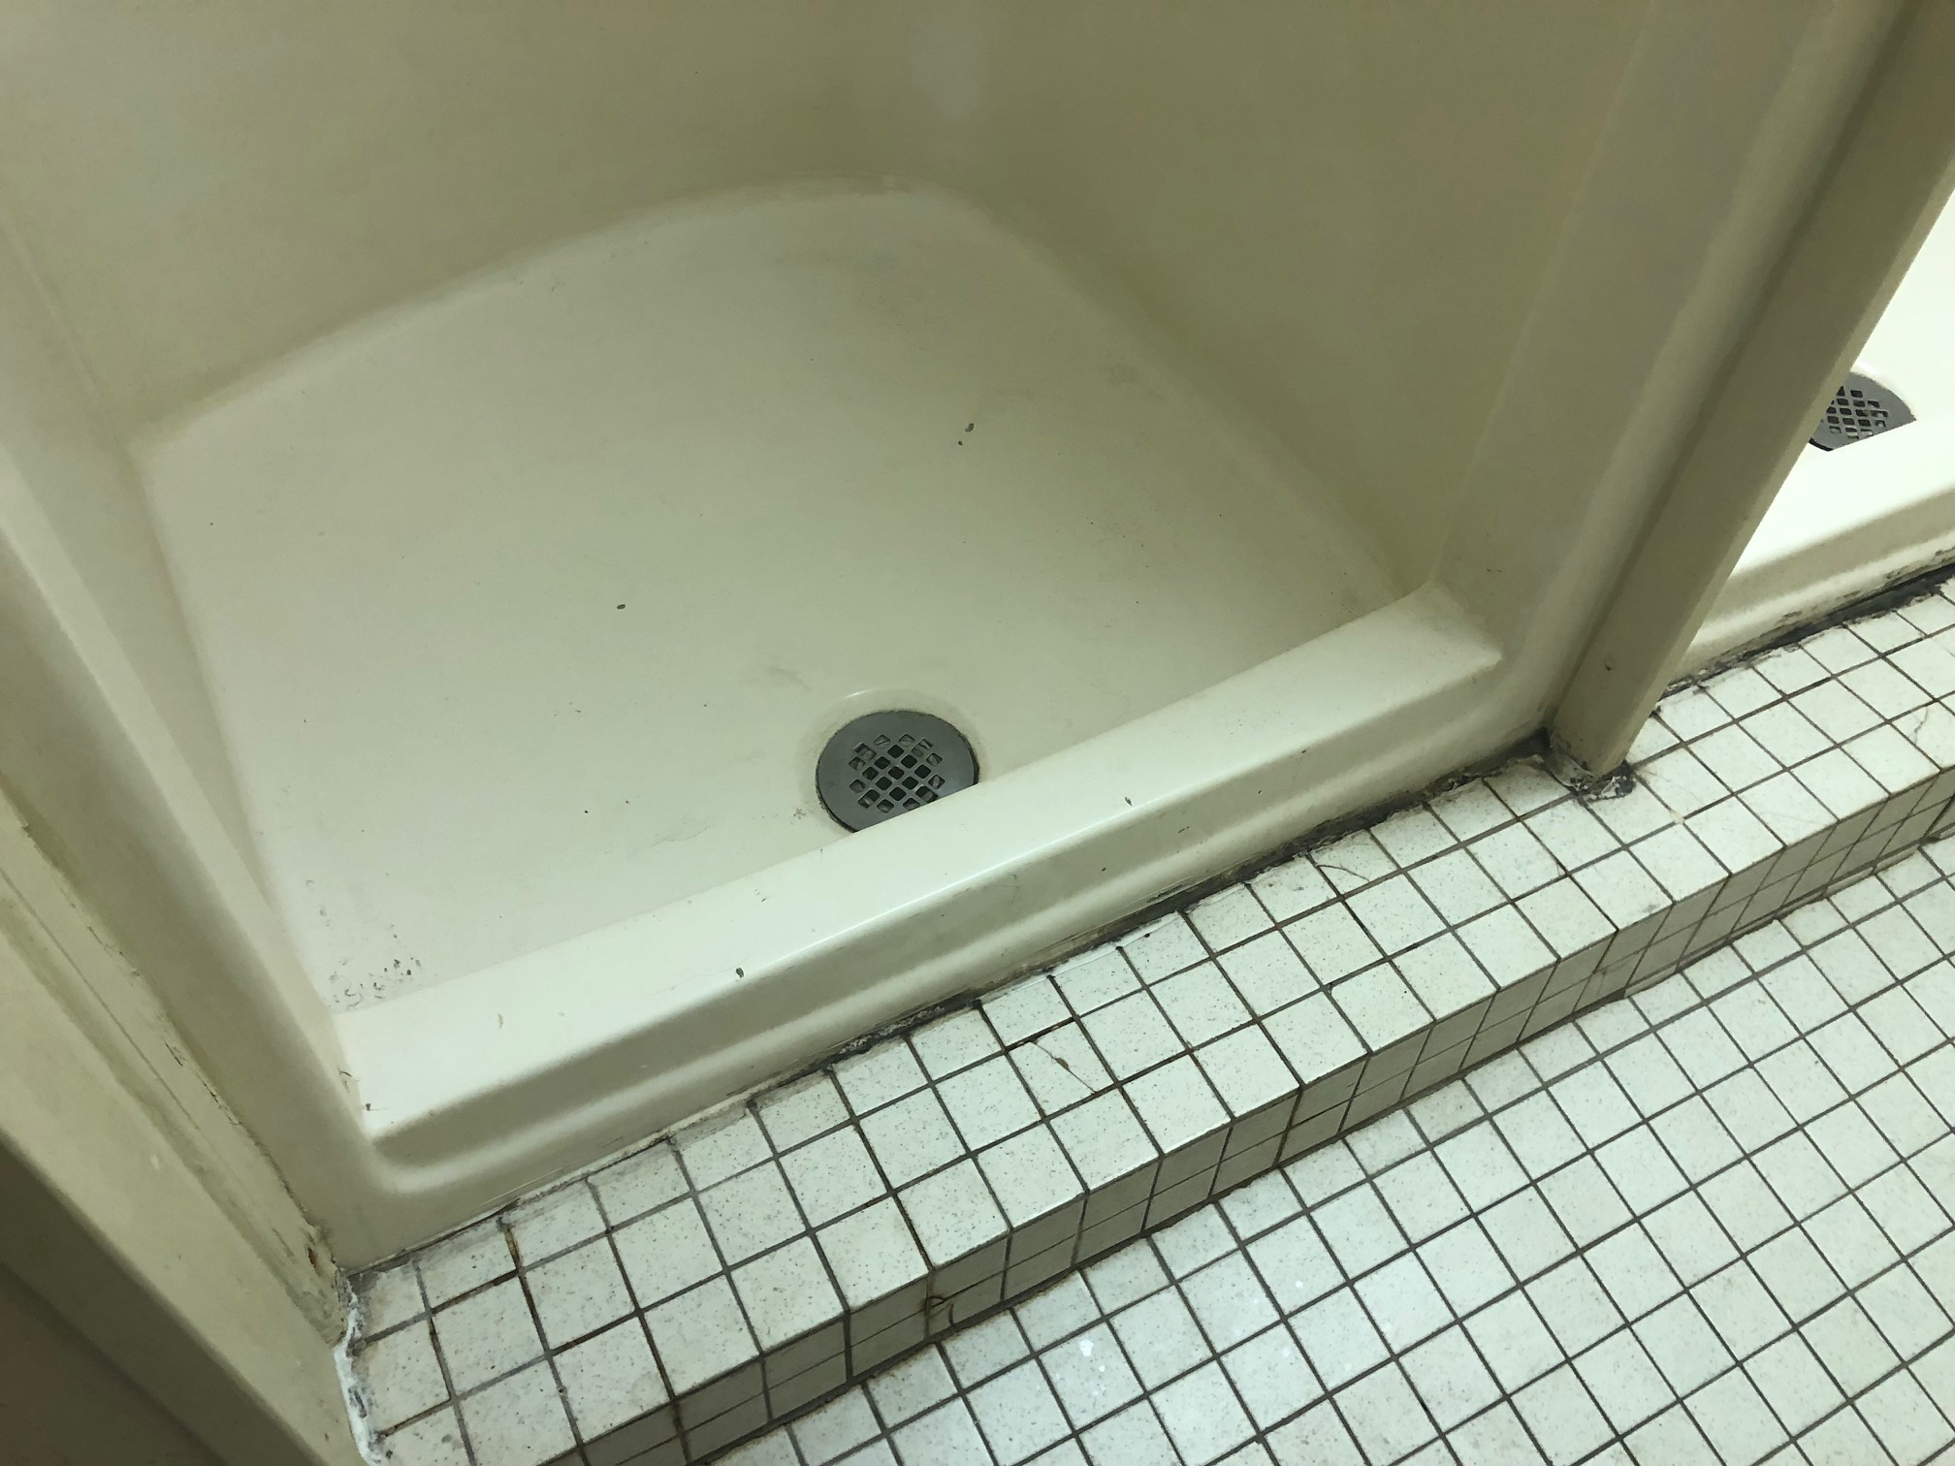
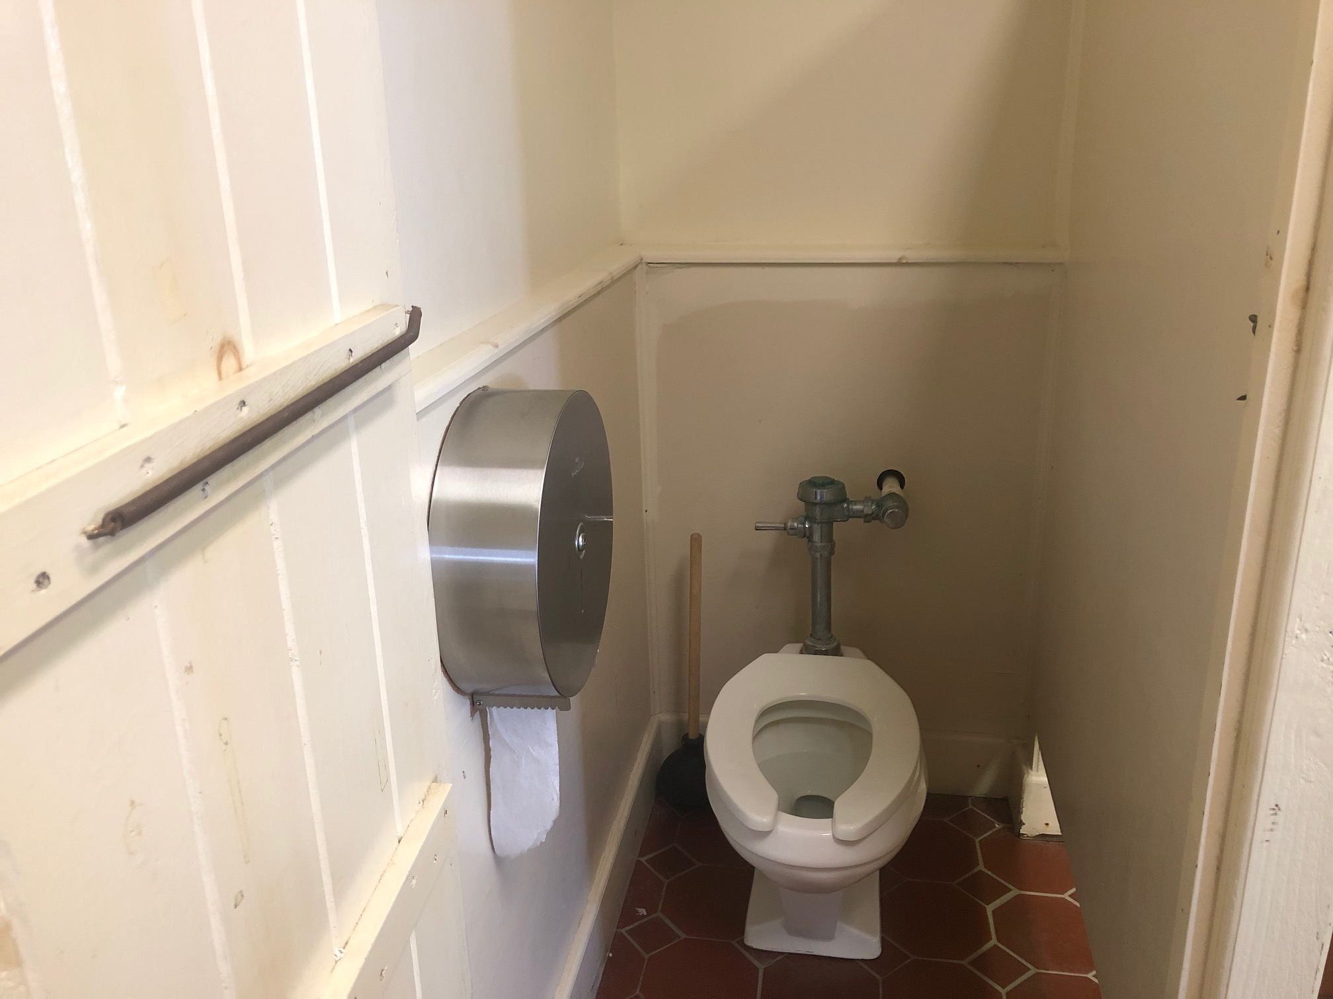
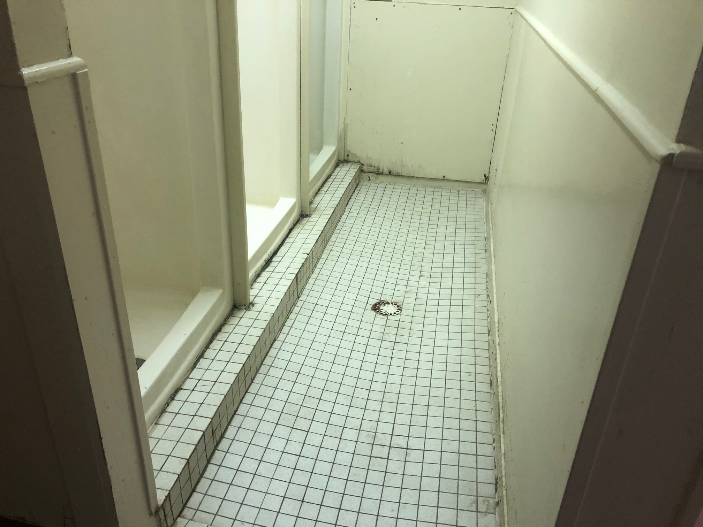
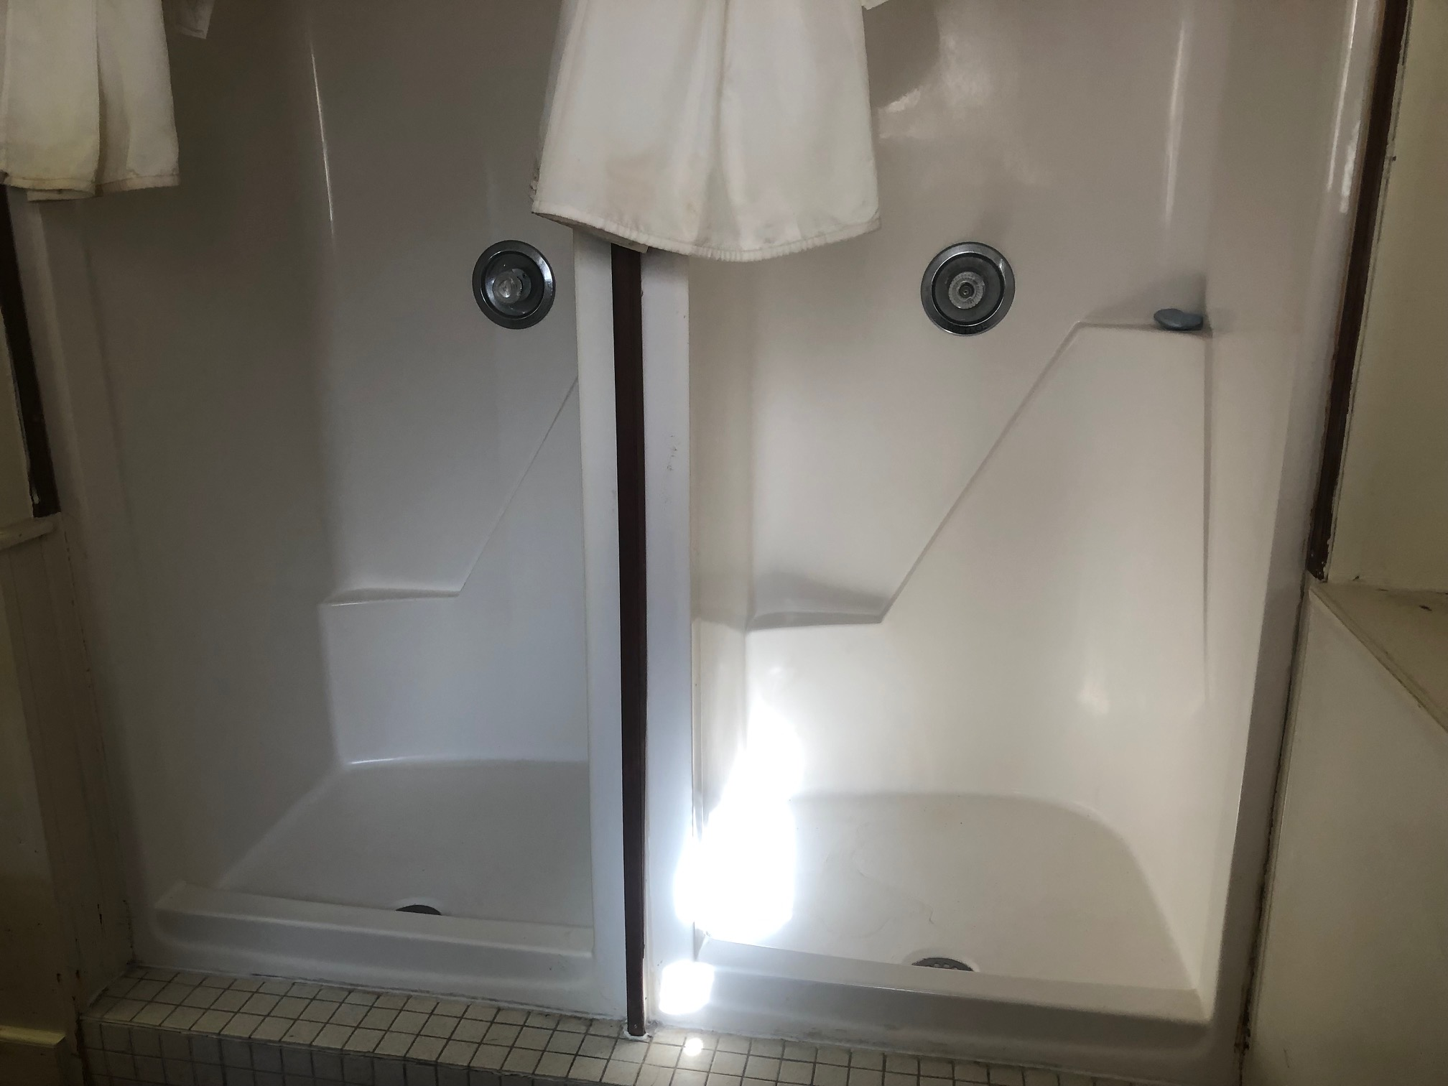
SHBP Headquarters BATHROOM AND SHOWER FACILITIES

Slide 12
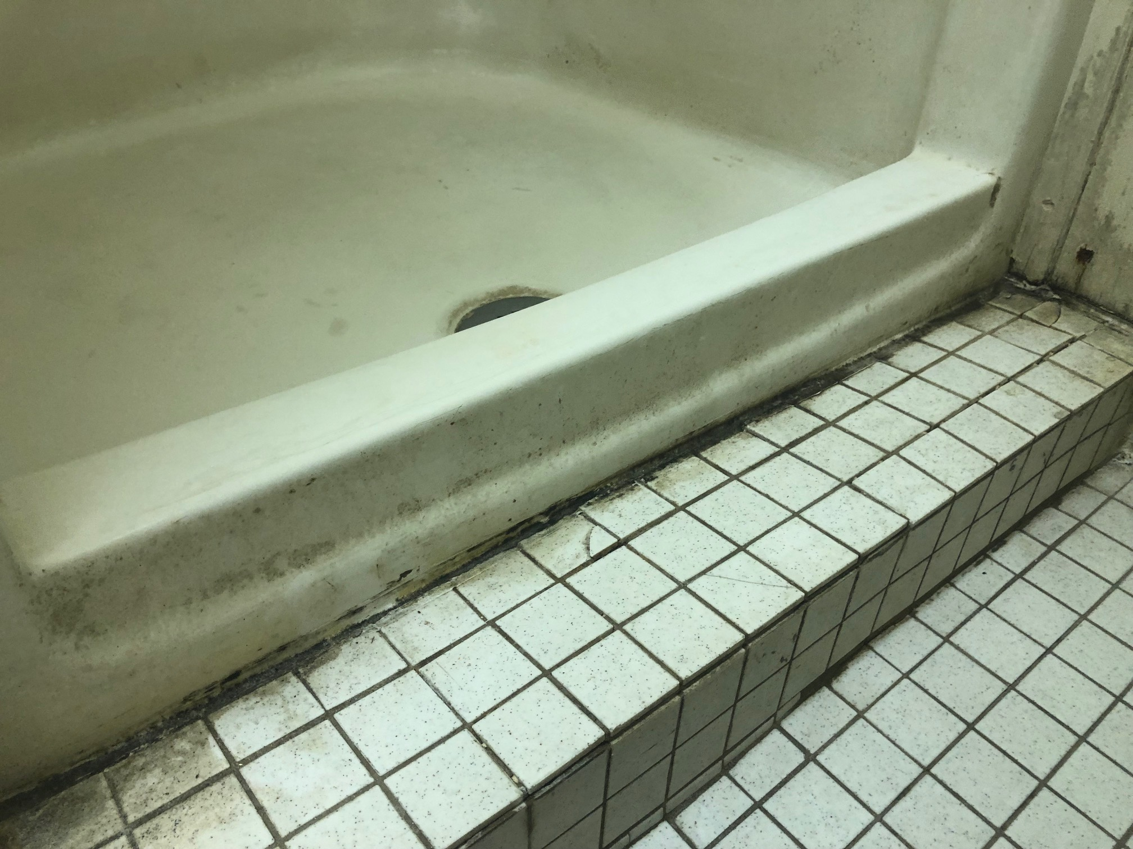
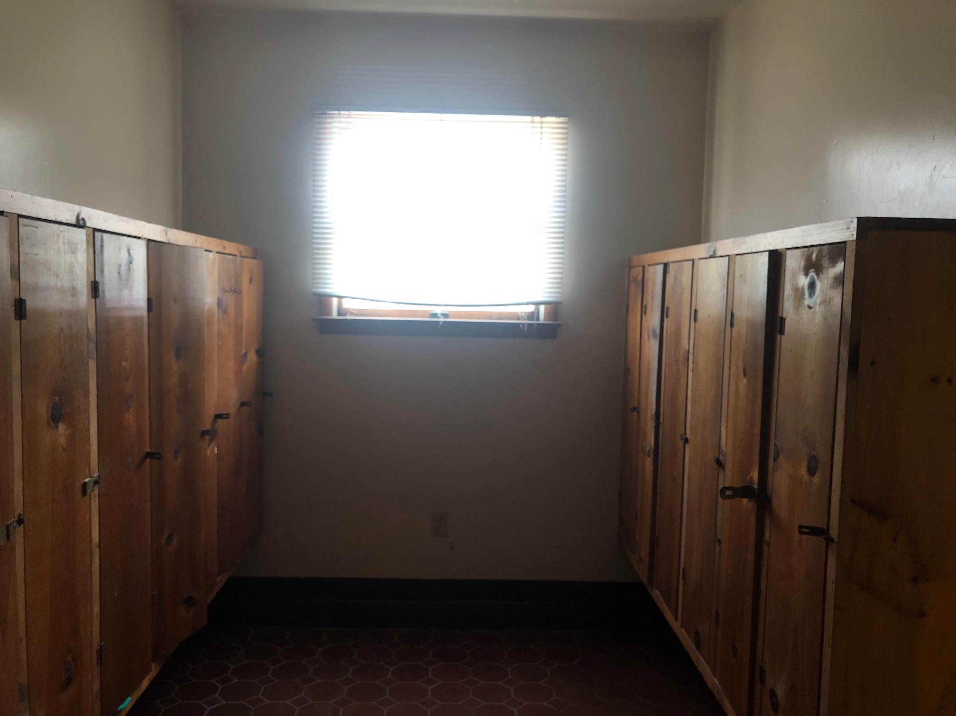
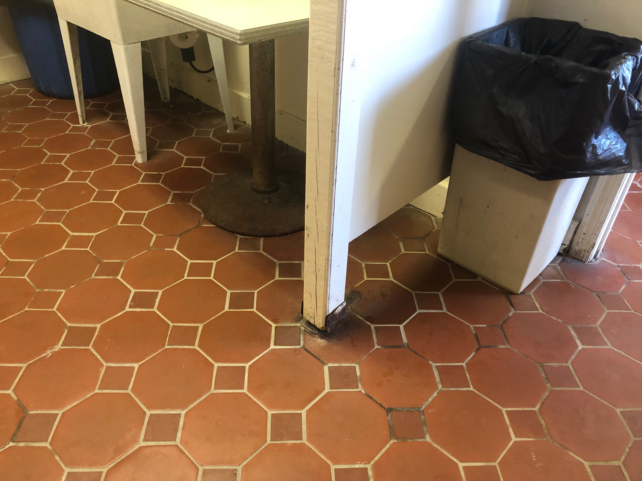
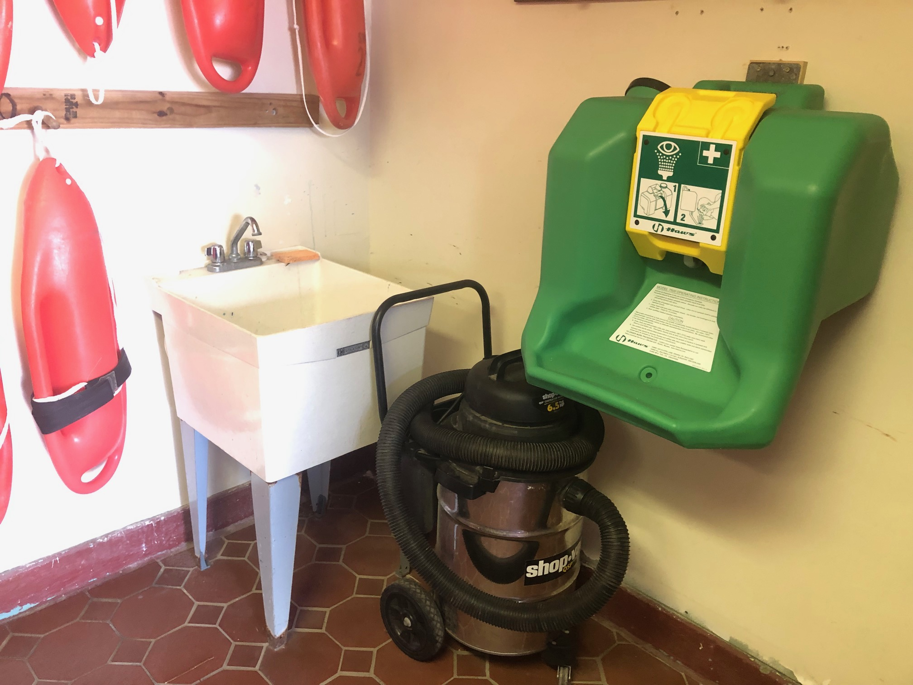
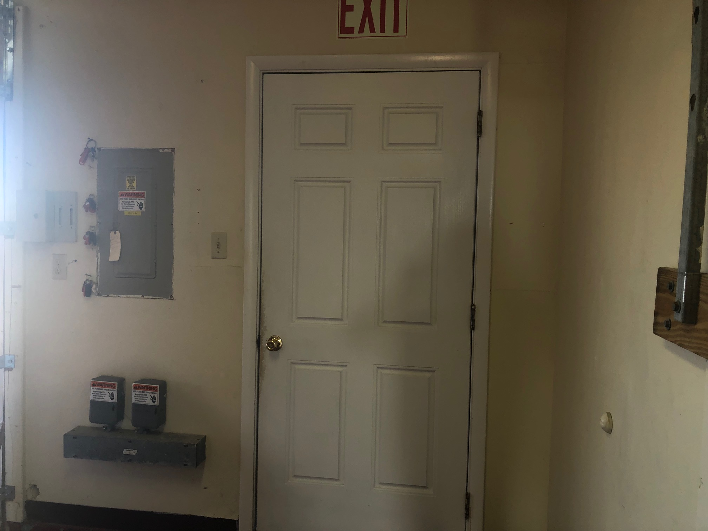
SHBP Headquarters MORE FIRST FLOOR

Slide 13
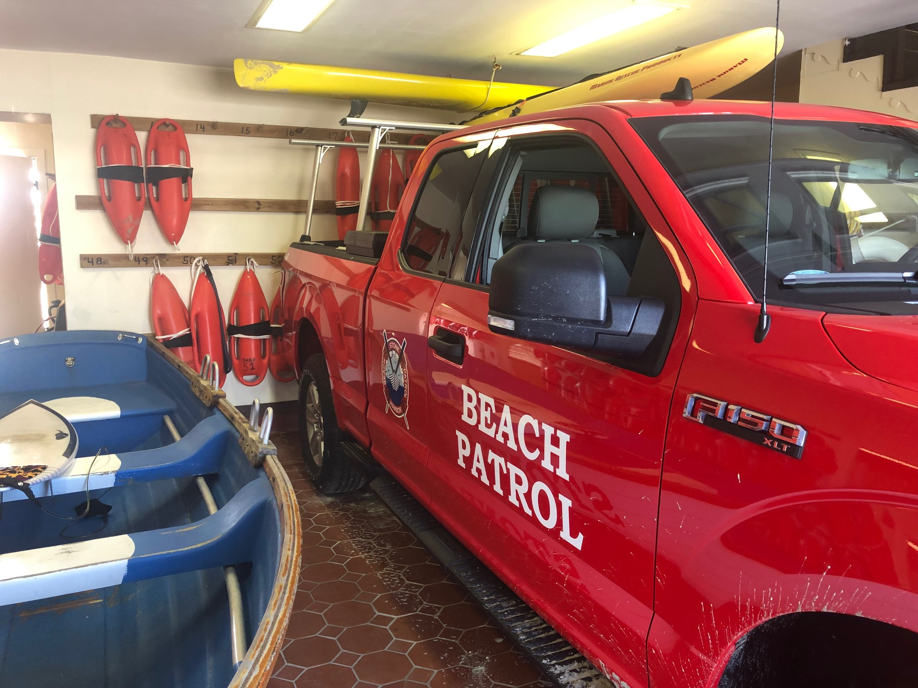
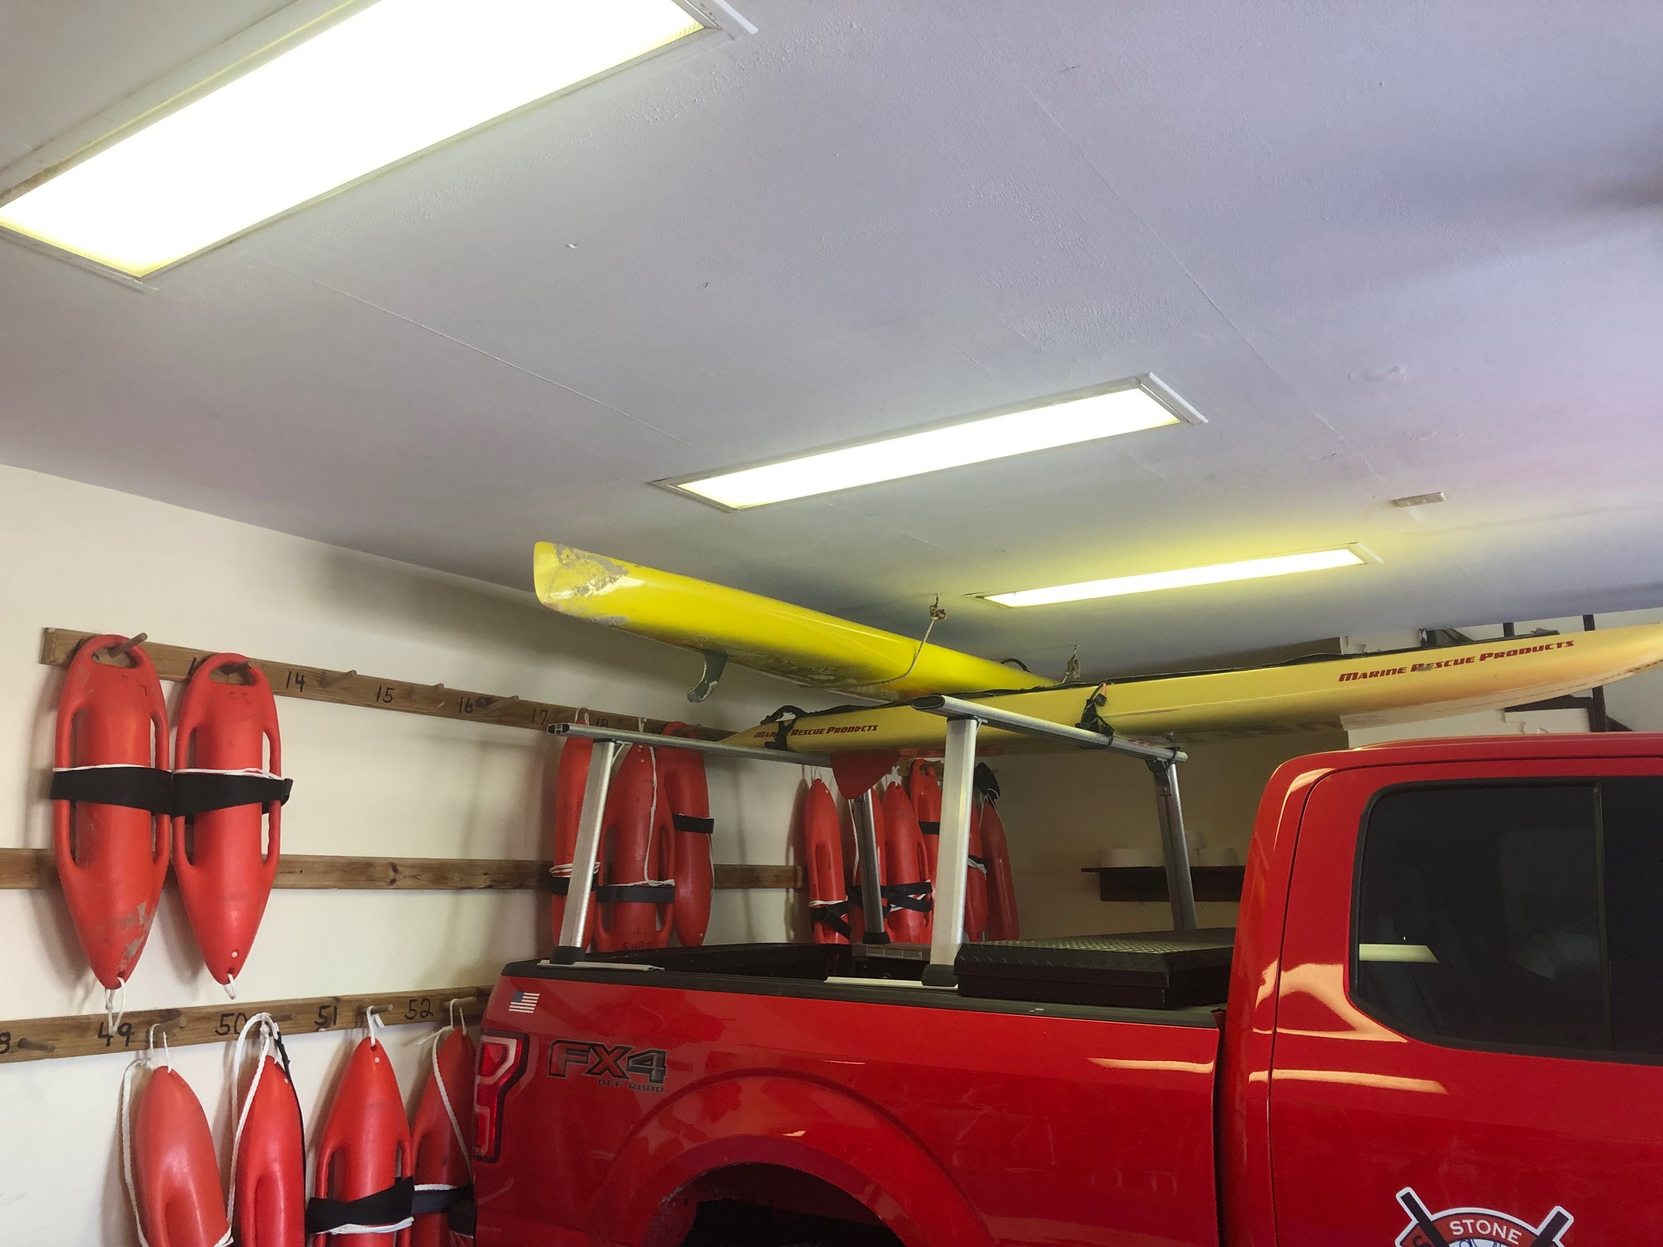
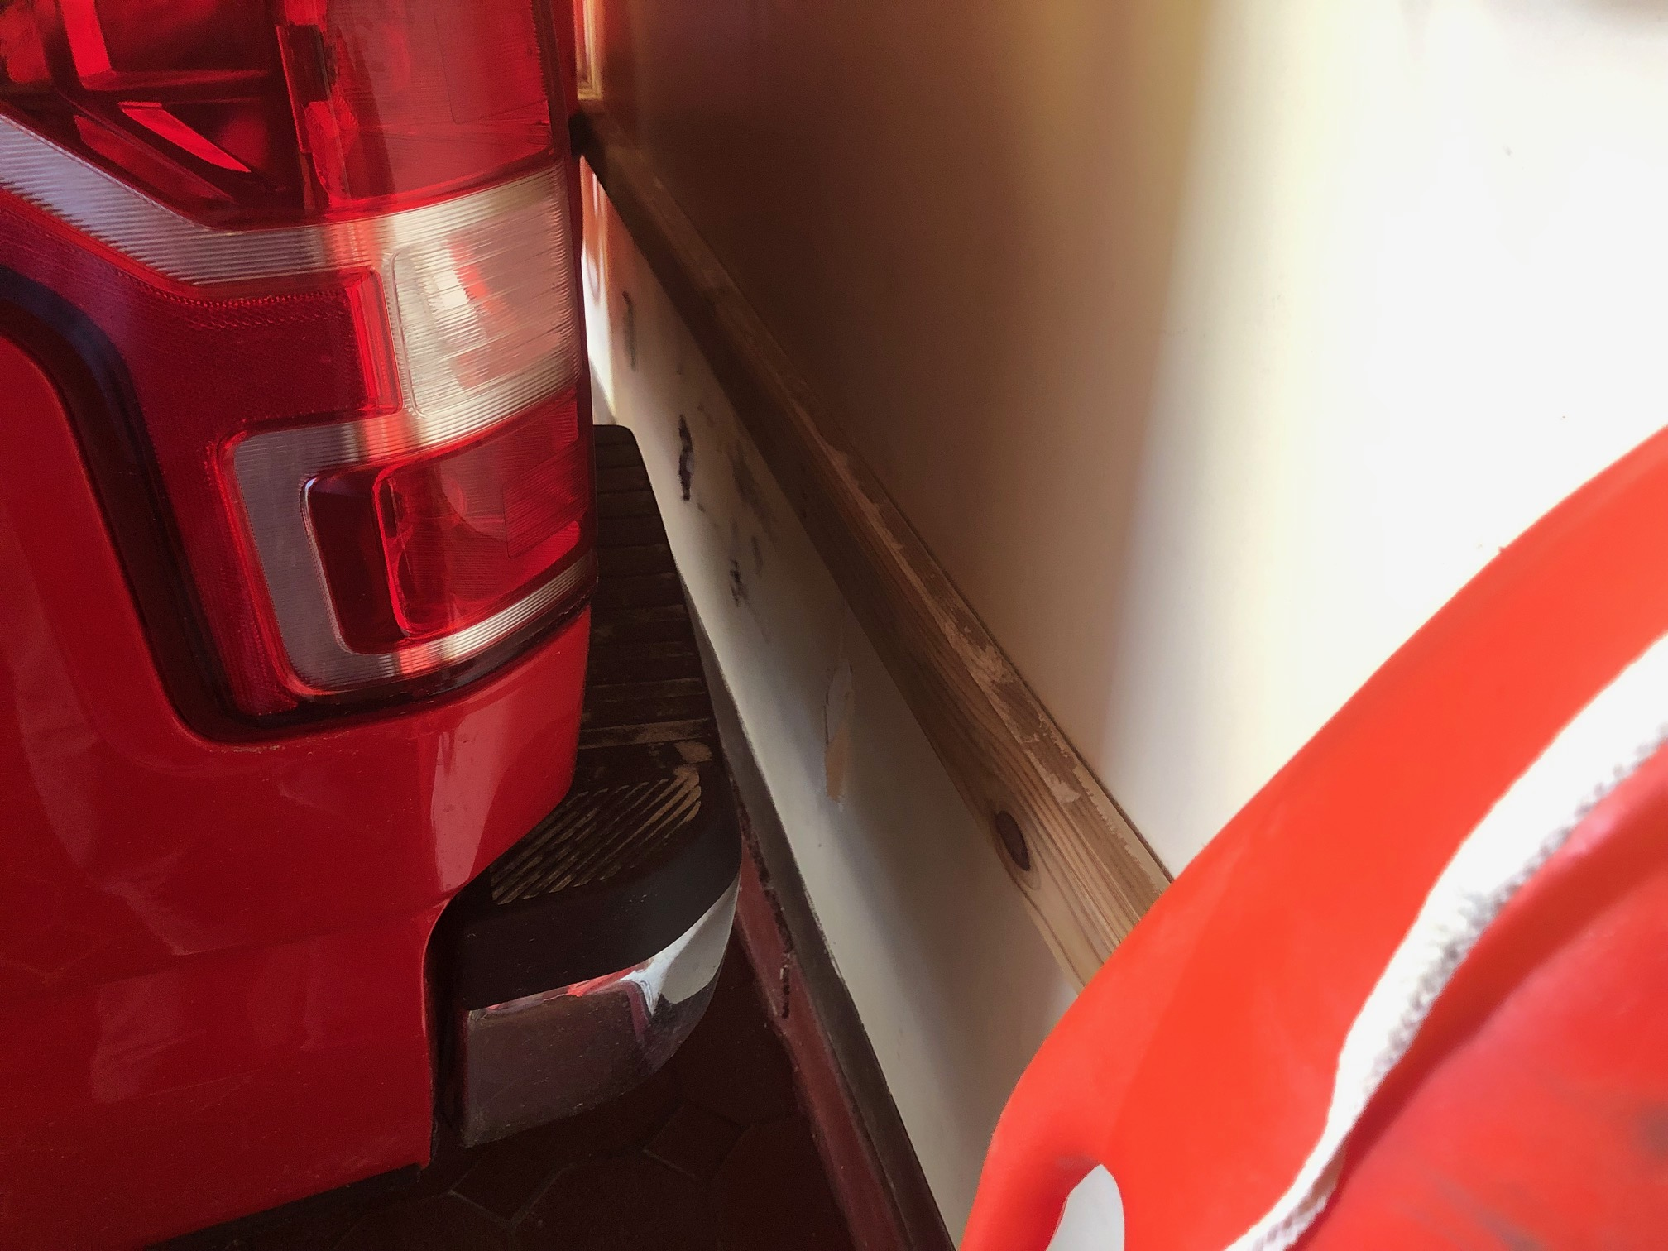
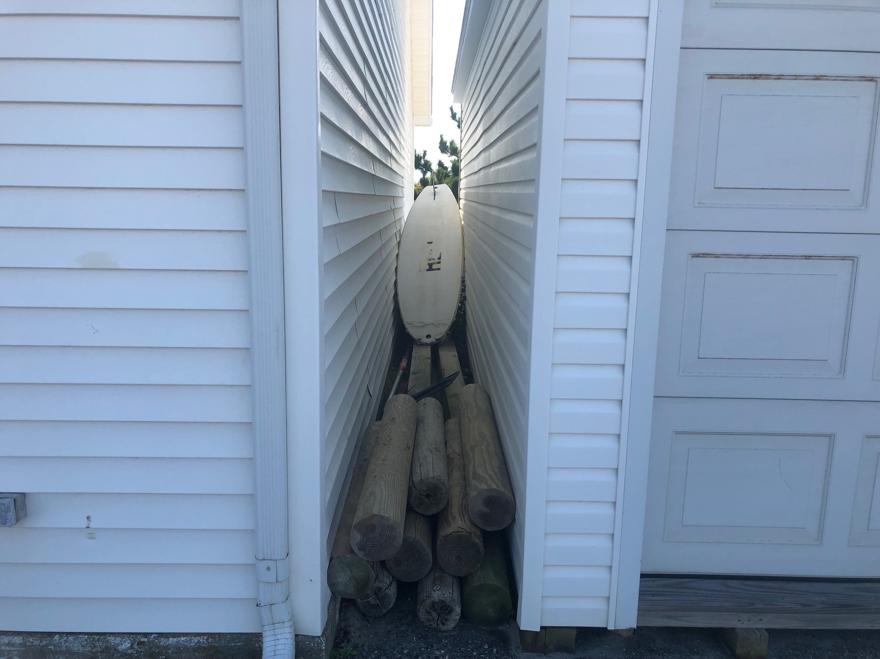
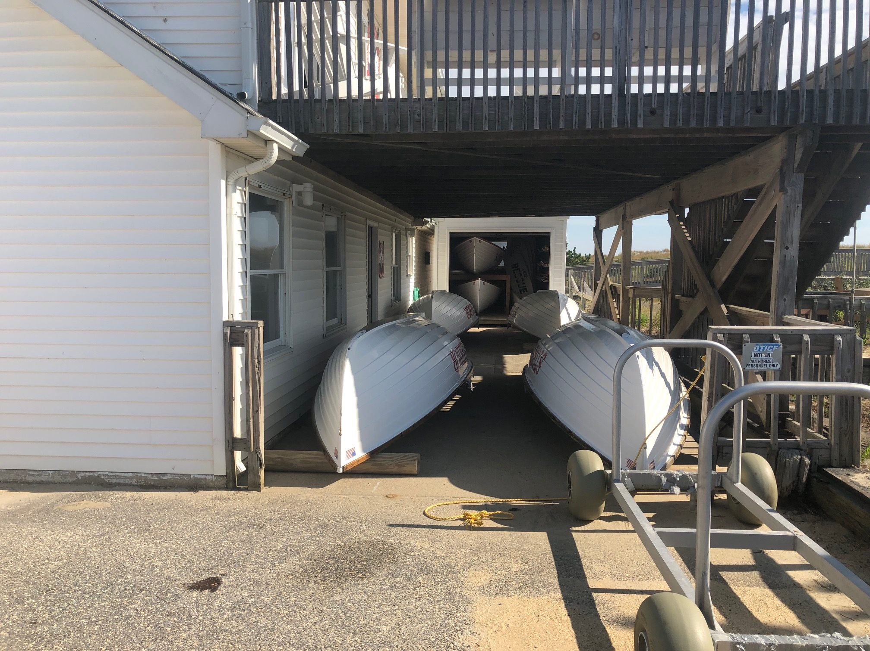
SHBP Headquarters FIRST FLOOR AND STORAGE

Slide 14
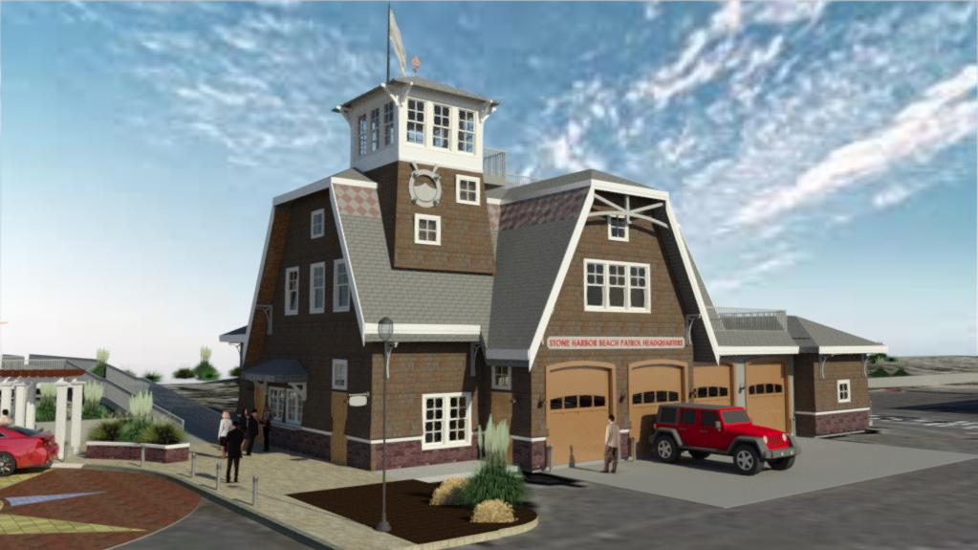
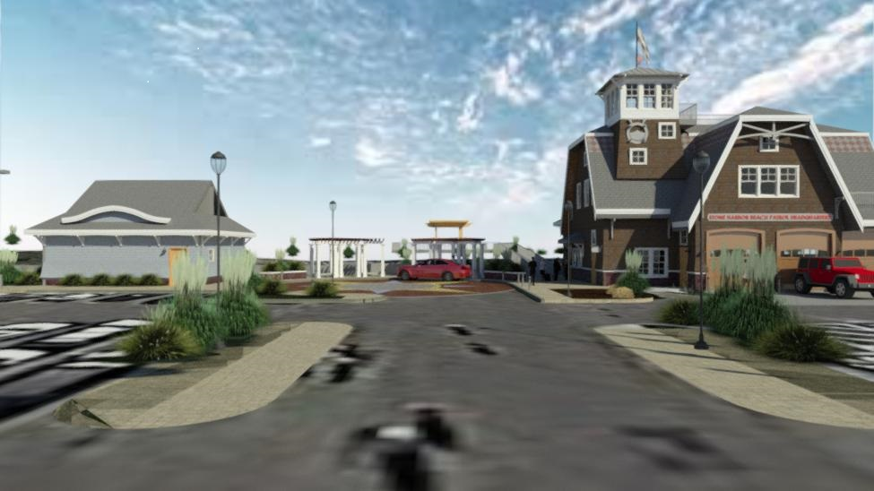
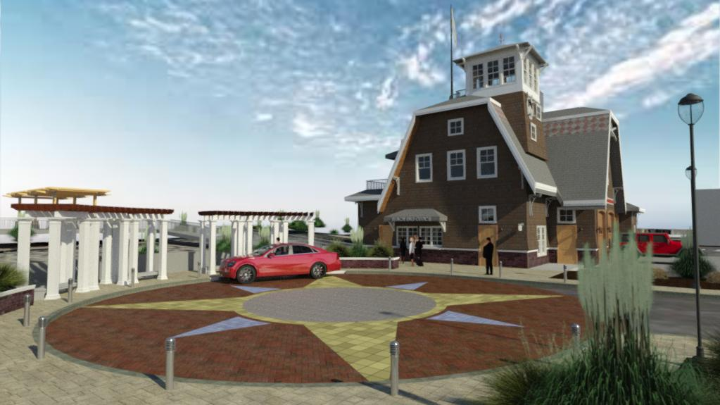
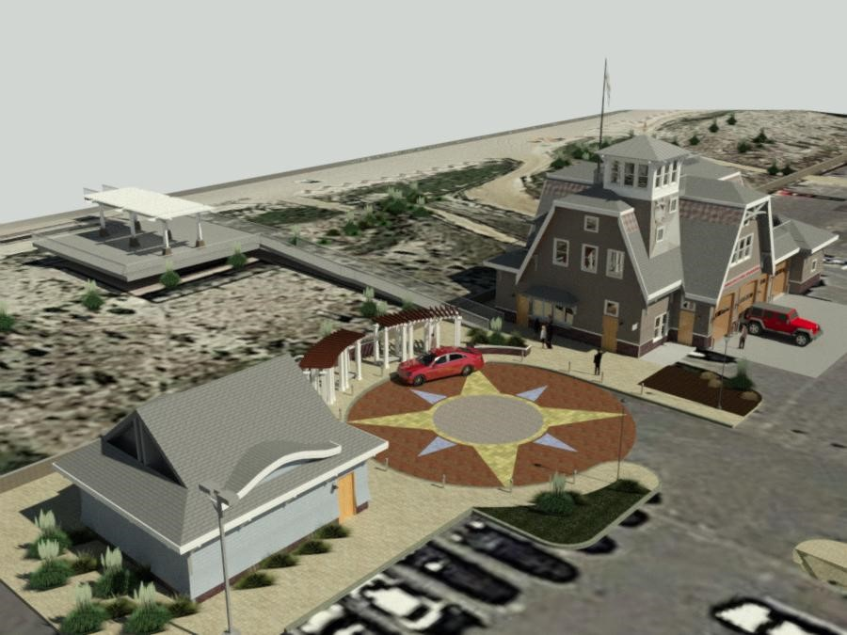
SHBP Headquarters PROPOSED DESIGN
(Presented at Council Workshop on August 20, 2019)
COST: $4,006,750
$3,642,500
($364,250)
(contingency)
Restroom: $460,000
SHBP HQ: $2,422,500
Demo: $50,000
Site Work: $525,000
Landscaping: $75,000
Pergolas: $60,000
Signage/Misc: $50,000

Slide 15
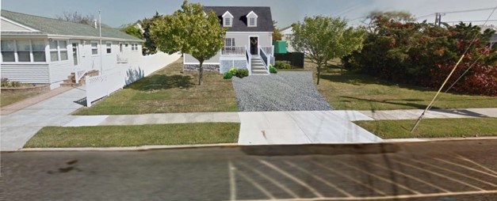
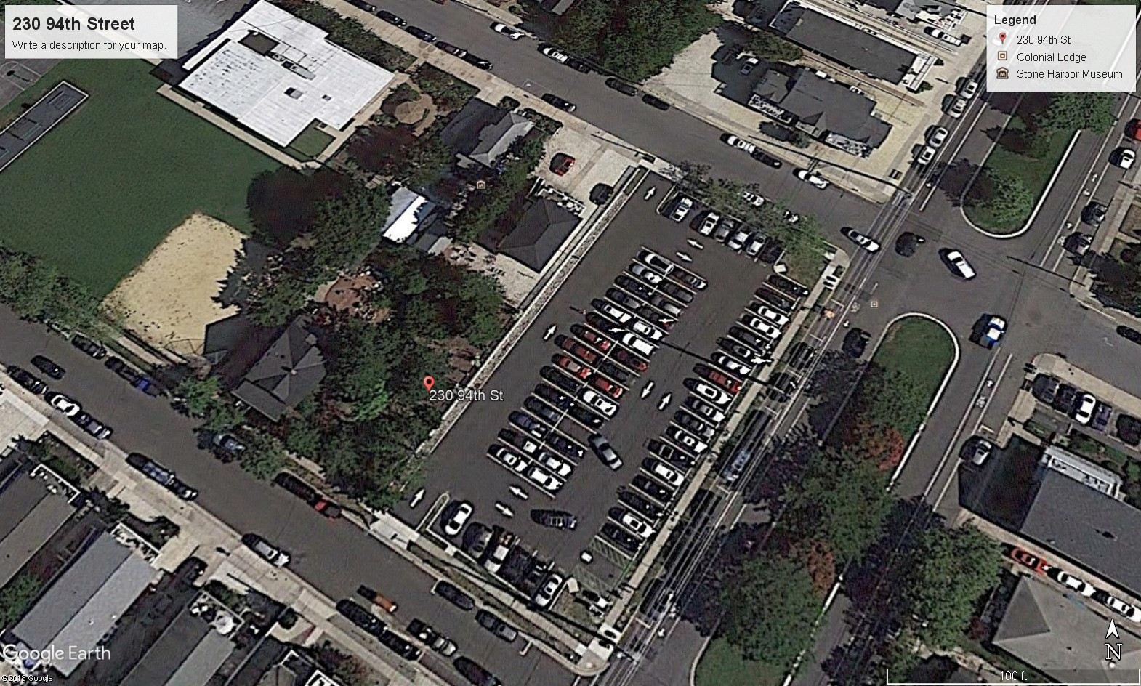
Storm Water Pump Station
Bid Prep and Award: Late July 2020
Construction: Late July 2020 through Late May 2022
Proposed Budget of Both Projects
$3,706,196 ($6,410,000 – $2,703,804) June of 2018
$1,000,050 (cost of 230 94th Street)
$2,000,000 (rerouting sewer force main, 200 Blocks
93rd & 94th reconstructed – paved, water
and sewer)
$6,706,196 Total
$9,410,050 Actual Cost
($2,703,804) (Flood Mitigation Grant)
300 block of 93rd Street
Sewer Pump Station
Bid Pre and Award: May 2020
Construction: September 2020 through
May 2021
230 94th Street

Slide 16
Ten Year Financial Plan For Beach & Bay

Slide 17
Smuggler’s Cove
370 83rd Street
Lot Size: 90 x 90
Assessment: $2,447,100
Land: 2,106,000
Improvements: 341,100
Taxes: 6,142

Slide 18
8310 Sunset Drive
Lot Size: 80 x 100
Assessment: $1,429,900
Land: 1,419,600
Improvements: 10,100
Taxes: 3,588
110’ Frontage on Sunset Drive
80’ Frontage on 83rd Street

Slide 19
Smuggler’s Cove & 8310 Sunset Drive
combined…..
TOTALS
Assessment: $ 3,876, 800
Land: 3,525,600
Improvements: 351,200
Taxes: 9,730

Slide 20
Smuggler’s Cove Financial Information

Slide 21
Aerial View of Smuggler’s Cove, Borough Marina,
81st Street & Third Avenue
Land Only
(3) 45’ X 110’ Bayfront lots
Assessment: $819,000 each
Total: $2,657,000

Slide 22
Questions & Answers

